Slide 1
^{Observation of Trifles}
June 8, 2016 10:30 AM
Alexandra Horowitz

Slide 2
Observations of trifles
Photo: Rudy Burckhardt

Slide 3
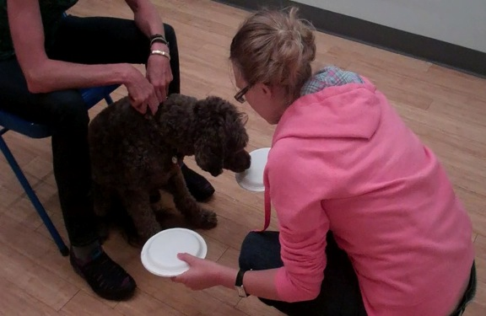
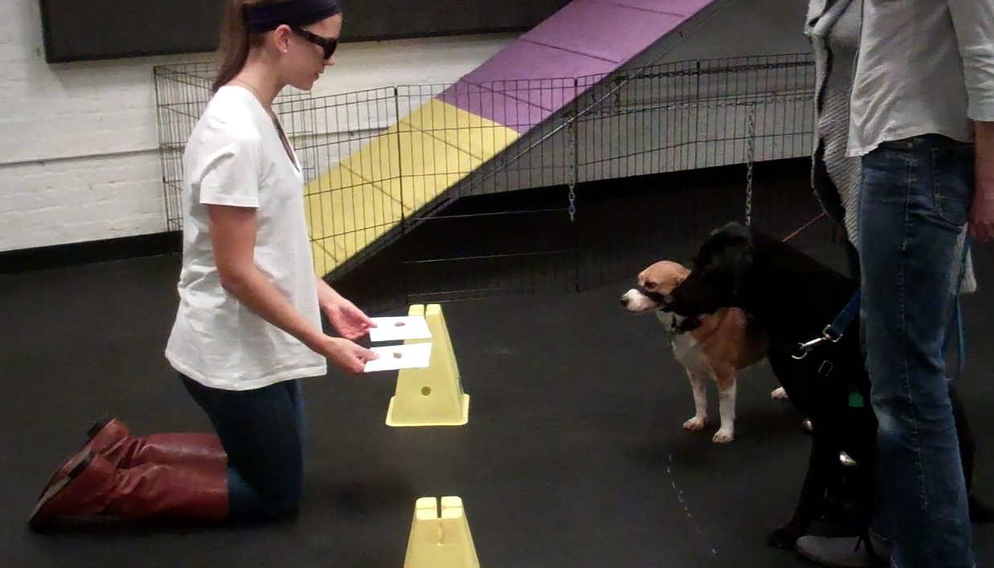
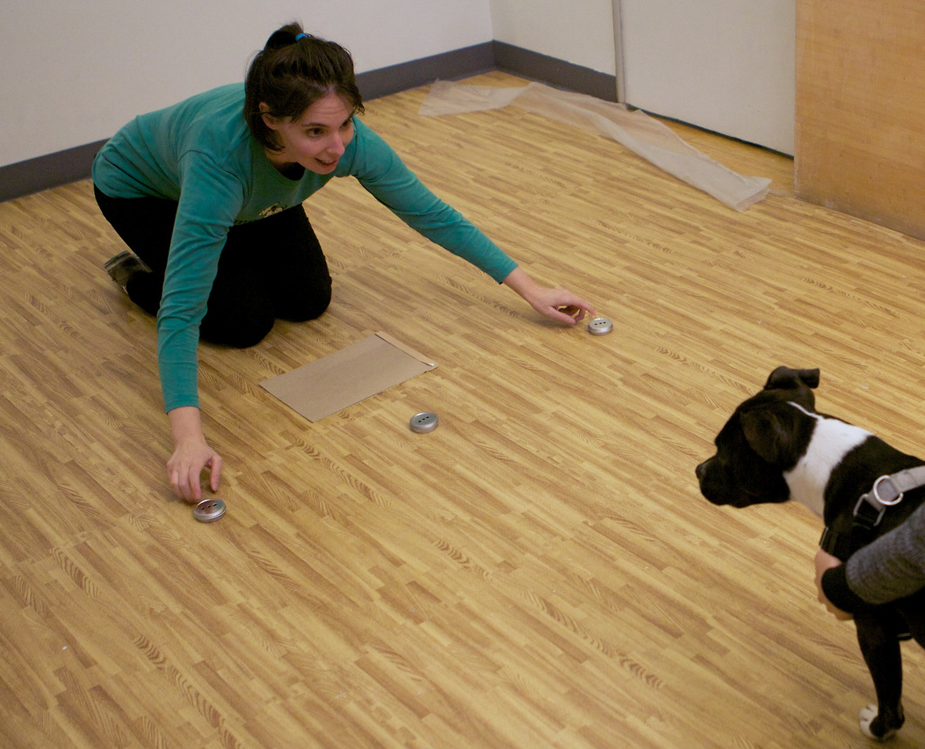
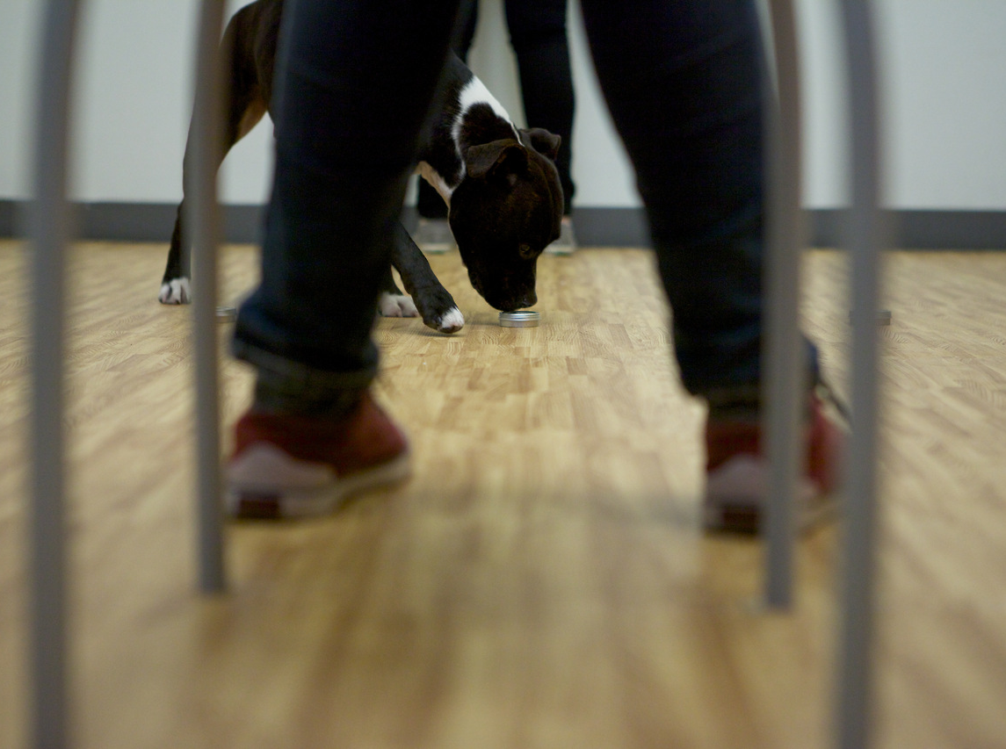
photo: Kane Niwa

Slide 4
photo: Kane Niwa

Slide 5
photo: Kane Niwa

Slide 6
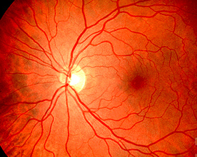
U of Michigan

Slide 7
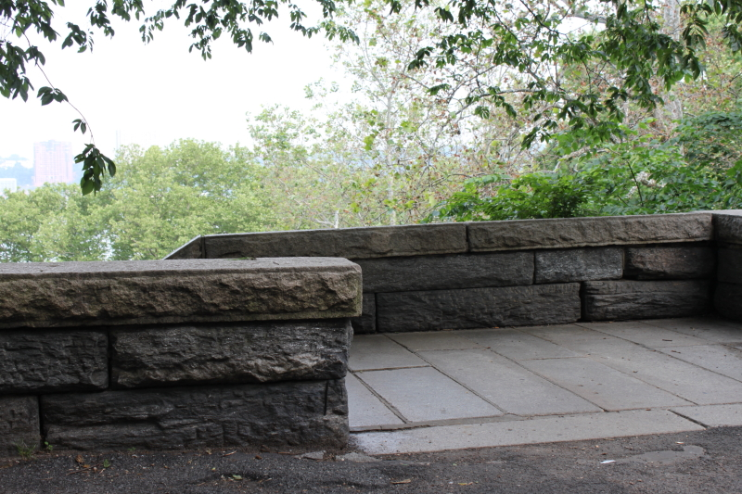
what we see
Notes:
Animal Behavior * Week 13
7
**If we want to understand dogs, we have to understand what the world is like if you can do this**
YOU can see your dog's interest in smell, of course SLIDE: the wall - stairs into the park - what we see is not what the dogs see/experience...

Slide 8
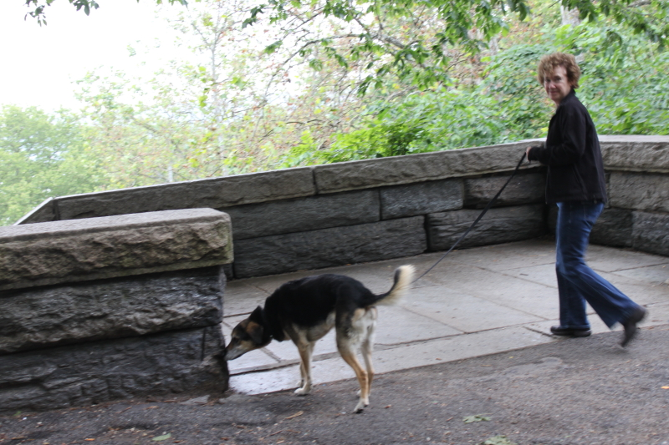
Notes:
Animal Behavior * Week 13
8

Slide 9
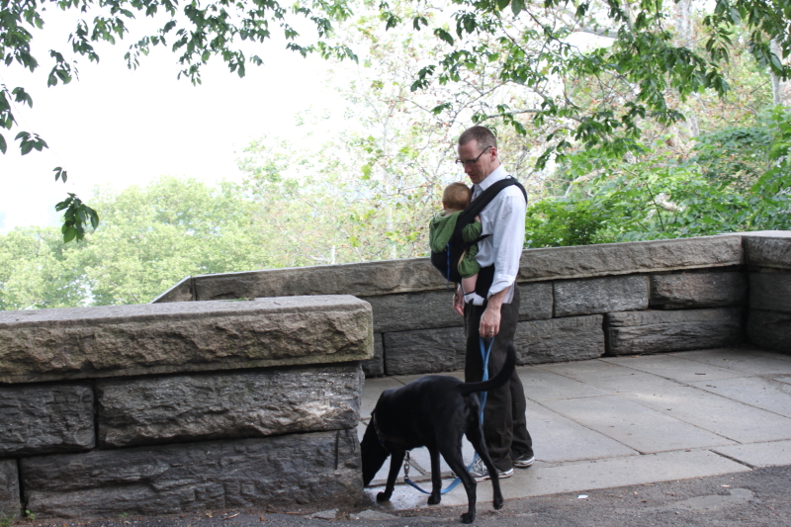
Notes:
Animal Behavior * Week 13
9

Slide 10
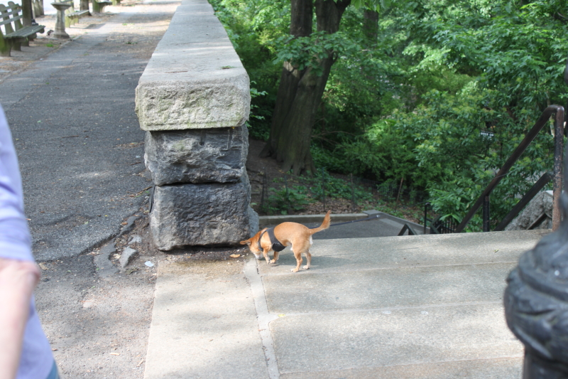
Notes:
Animal Behavior * Week 13
10

Slide 11
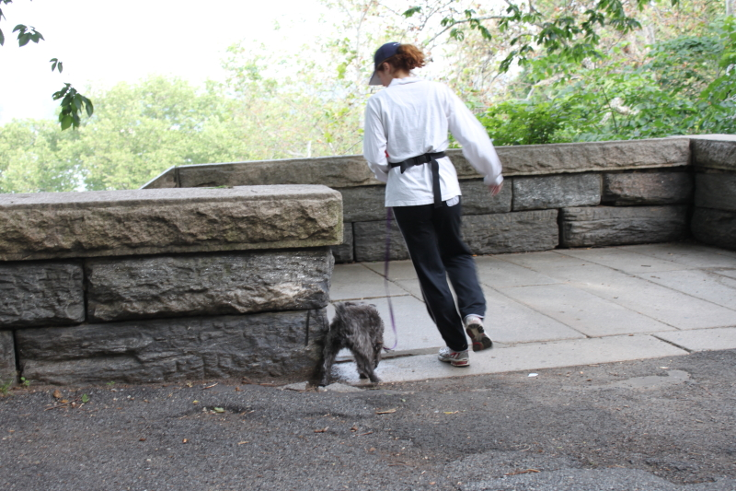
Notes:
Animal Behavior * Week 13
11

Slide 12
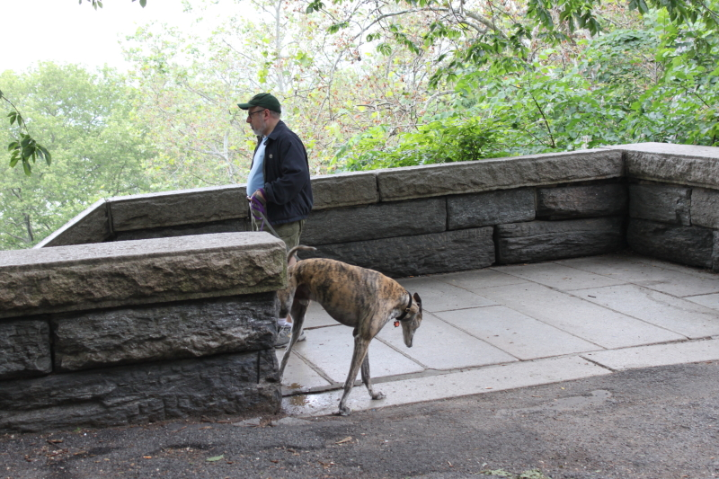
Notes:
Animal Behavior * Week 13
12

Slide 13
☞ “space is not a flat surface across which we walk…you’re cutting across a myriad of stories going on”
-Doreen Massey

Slide 14
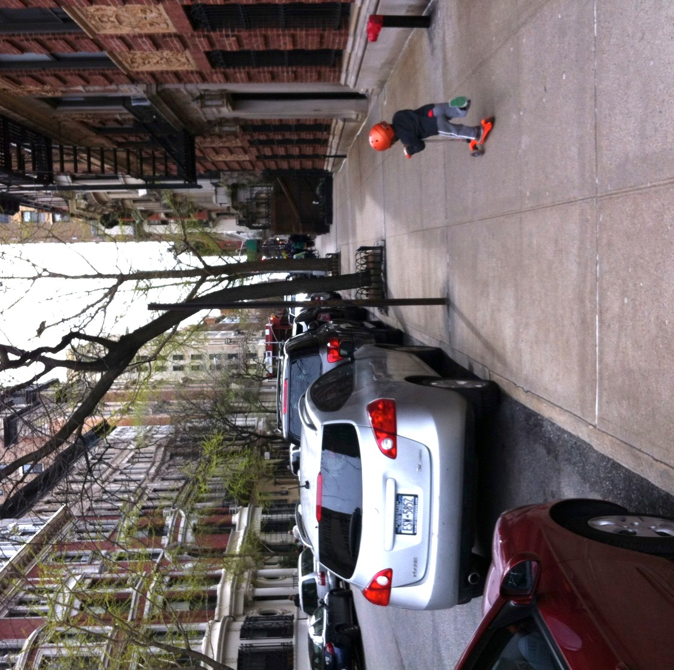
Notes:
14

Slide 15
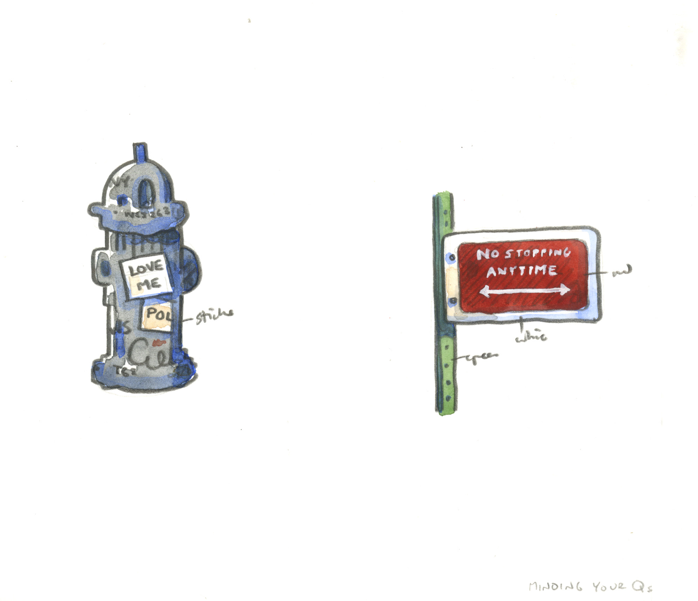
Images: Elisha Cooper

Slide 16
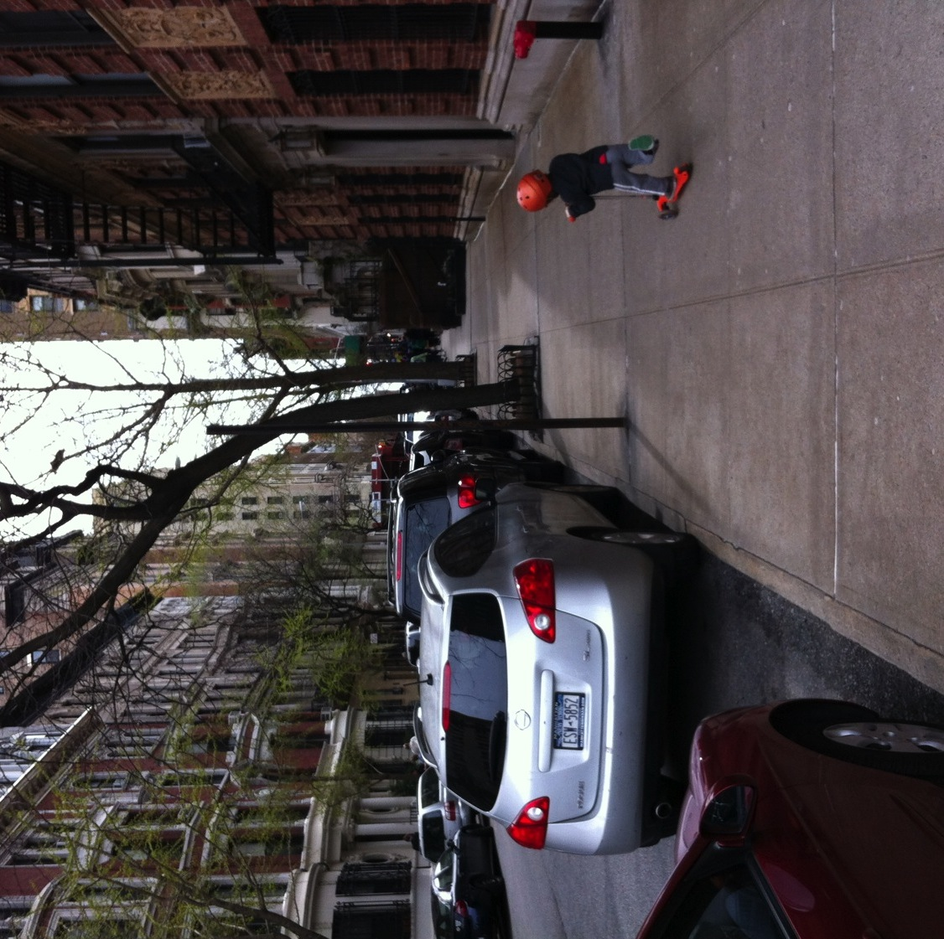
Notes:
16

Slide 17


Slide 18
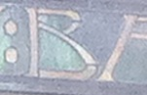

Slide 22
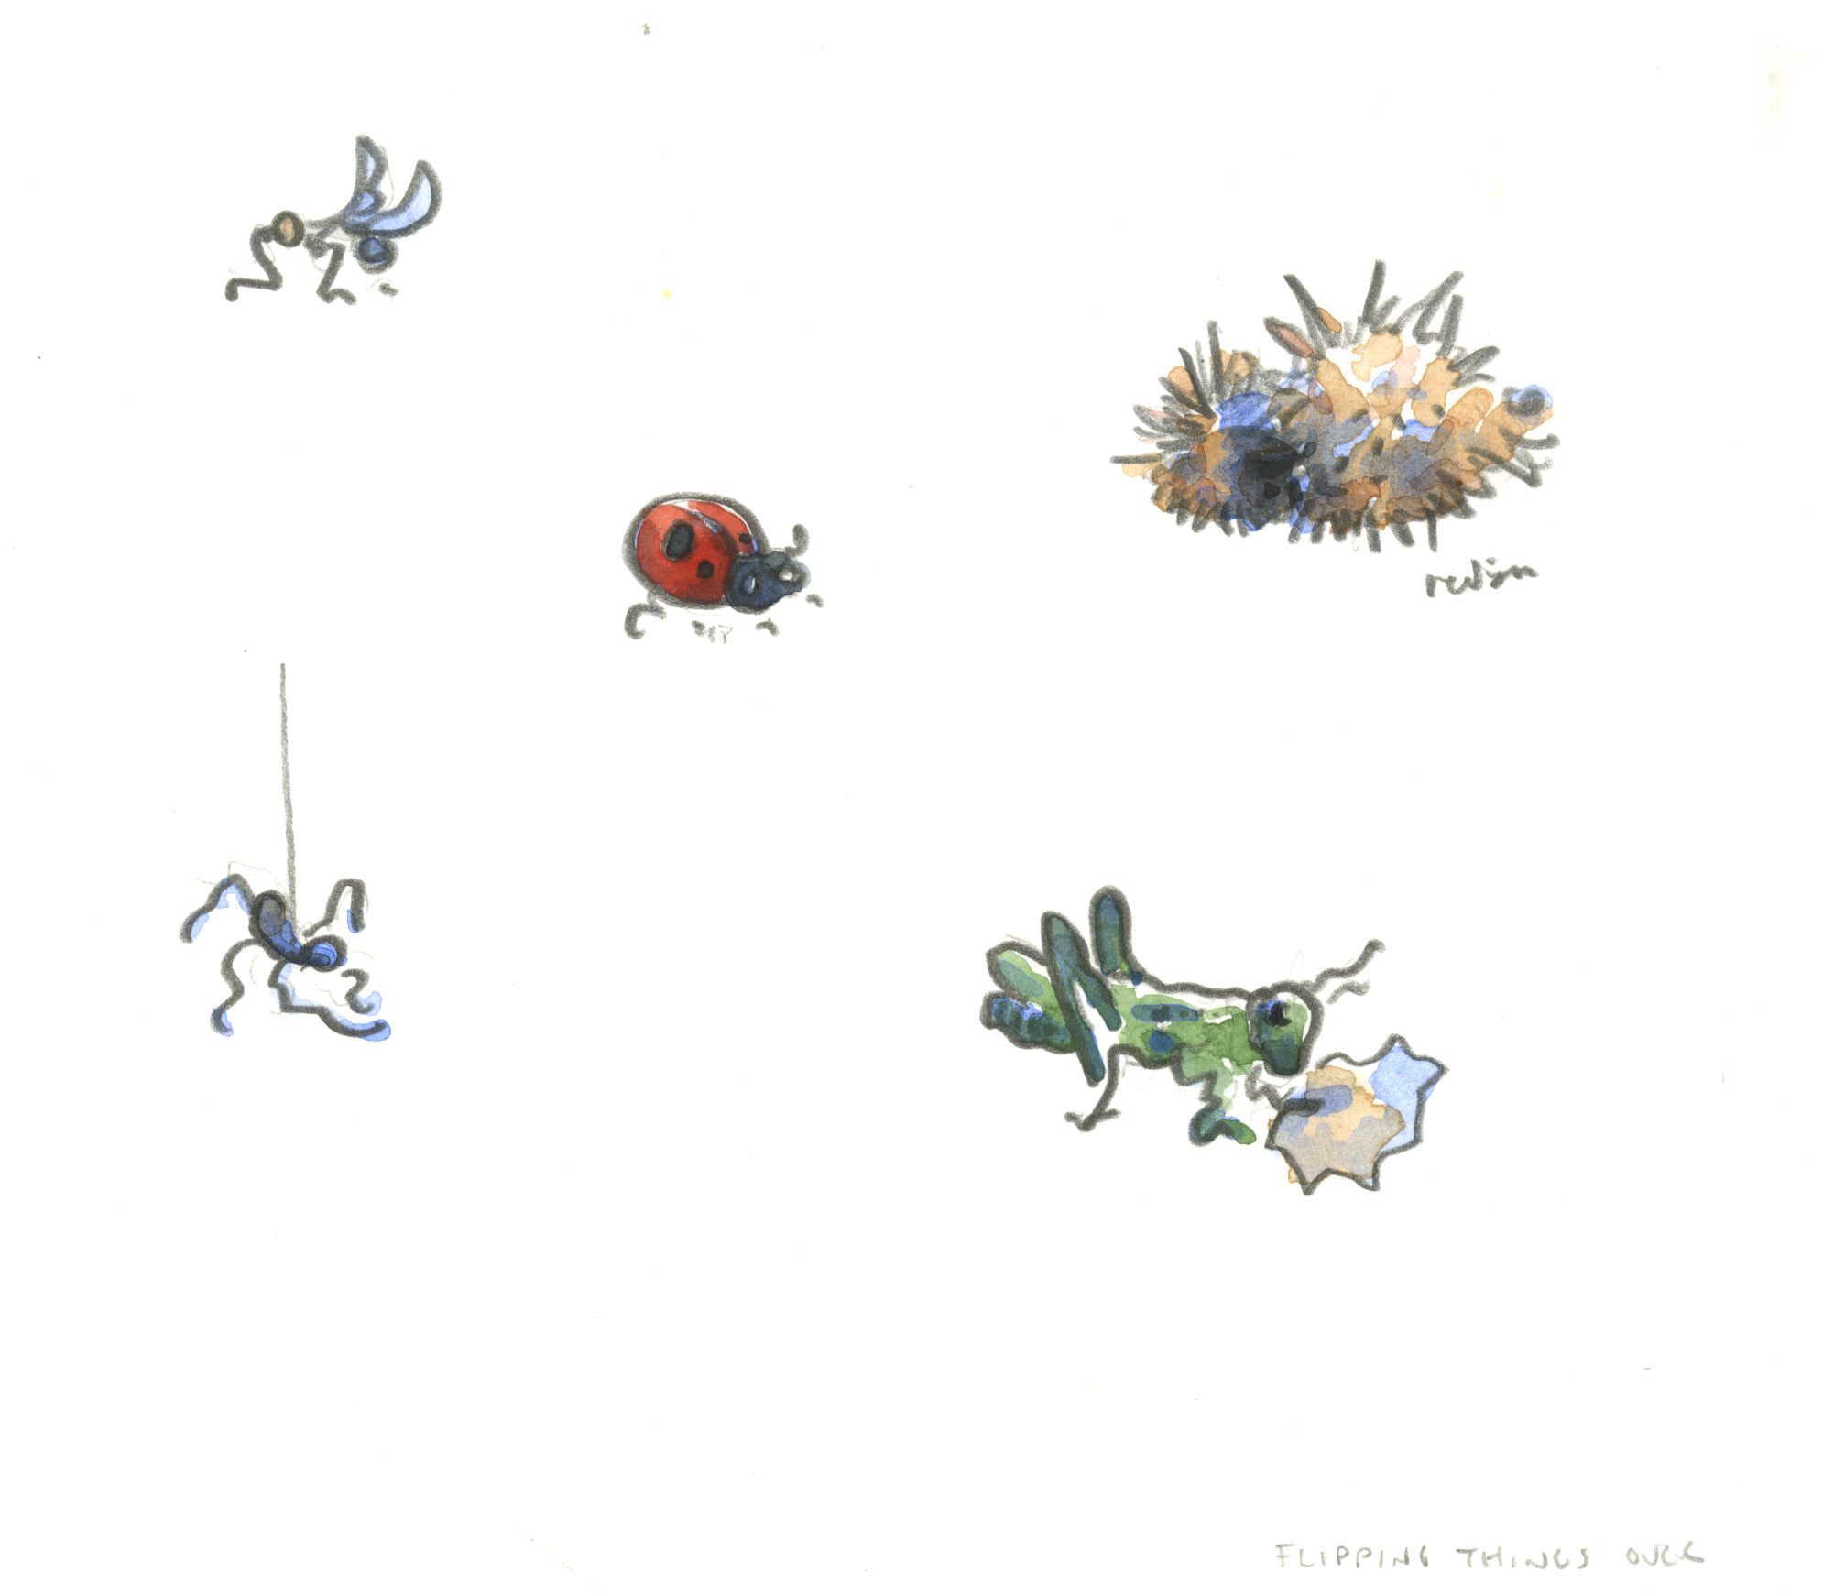

Slide 23
Notes:
23

Slide 24
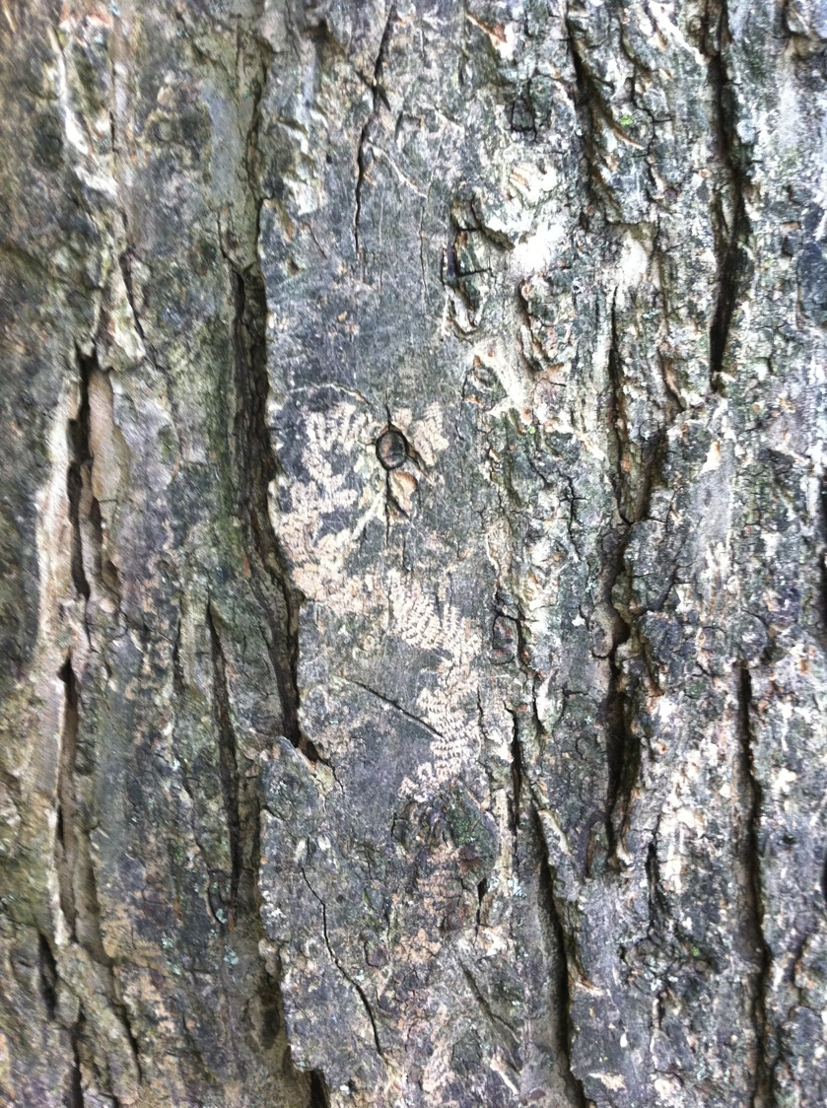

Slide 25
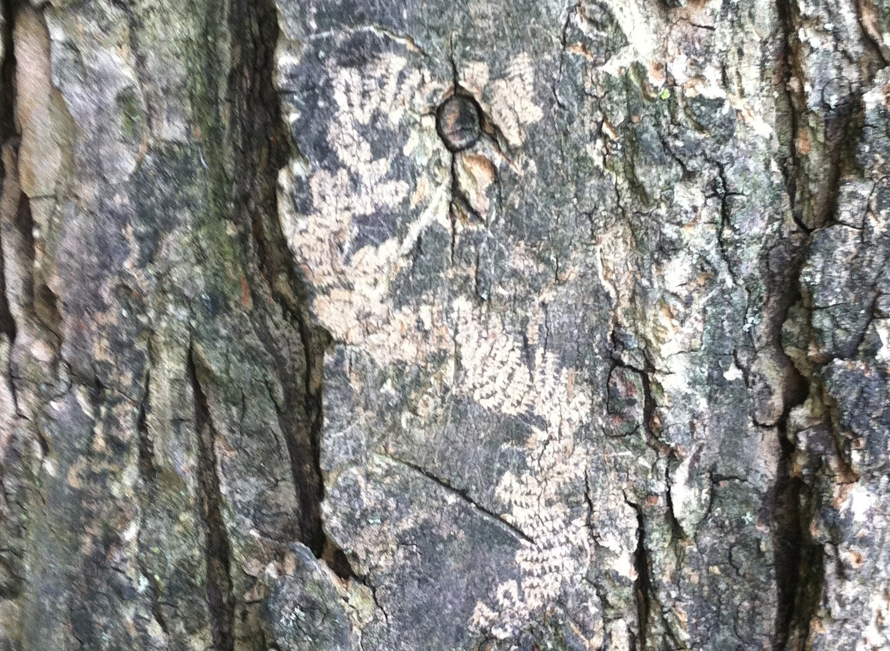

Slide 26
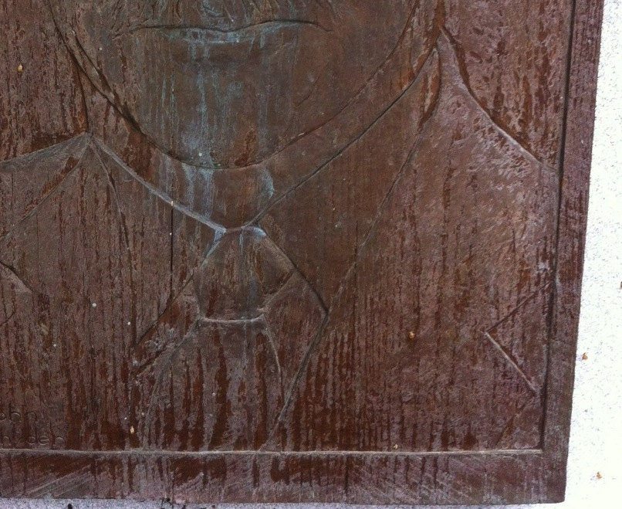

Slide 27
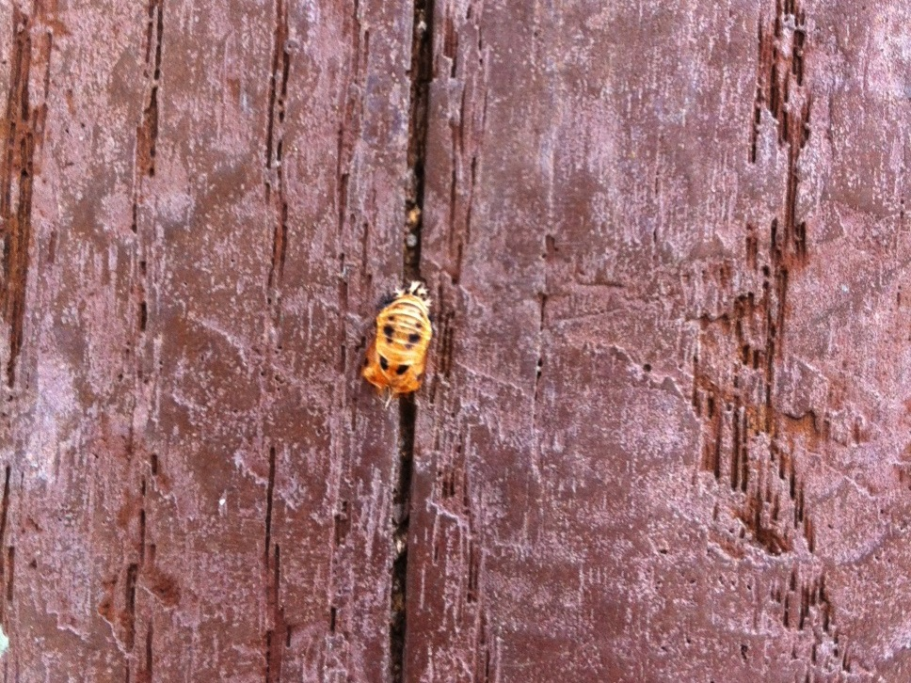

Slide 28
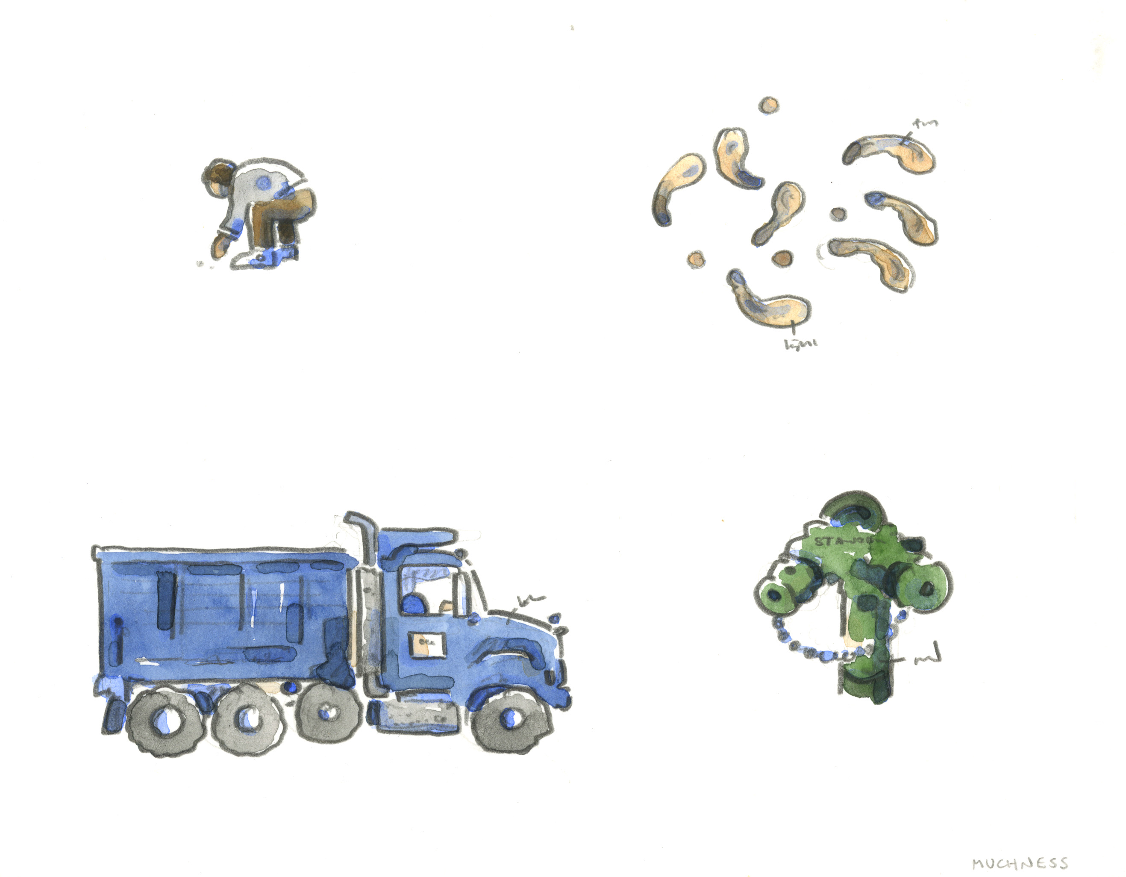

Slide 29
Notes:
29

Slide 30
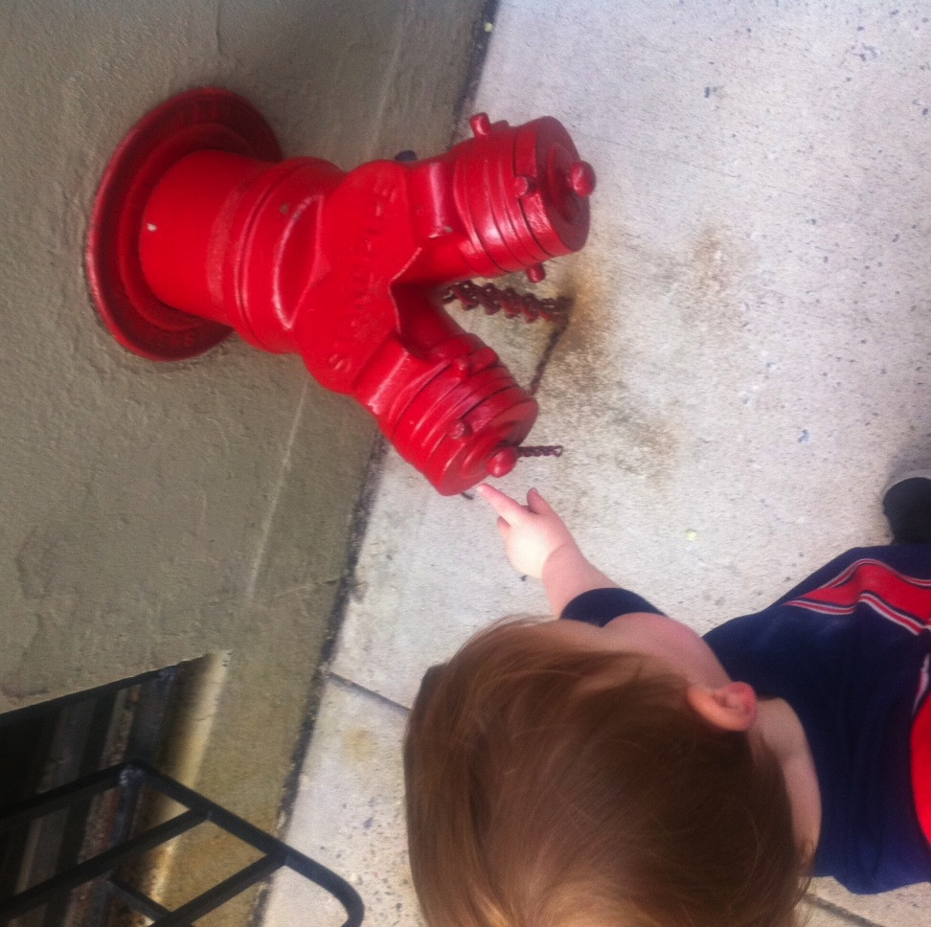

Slide 31
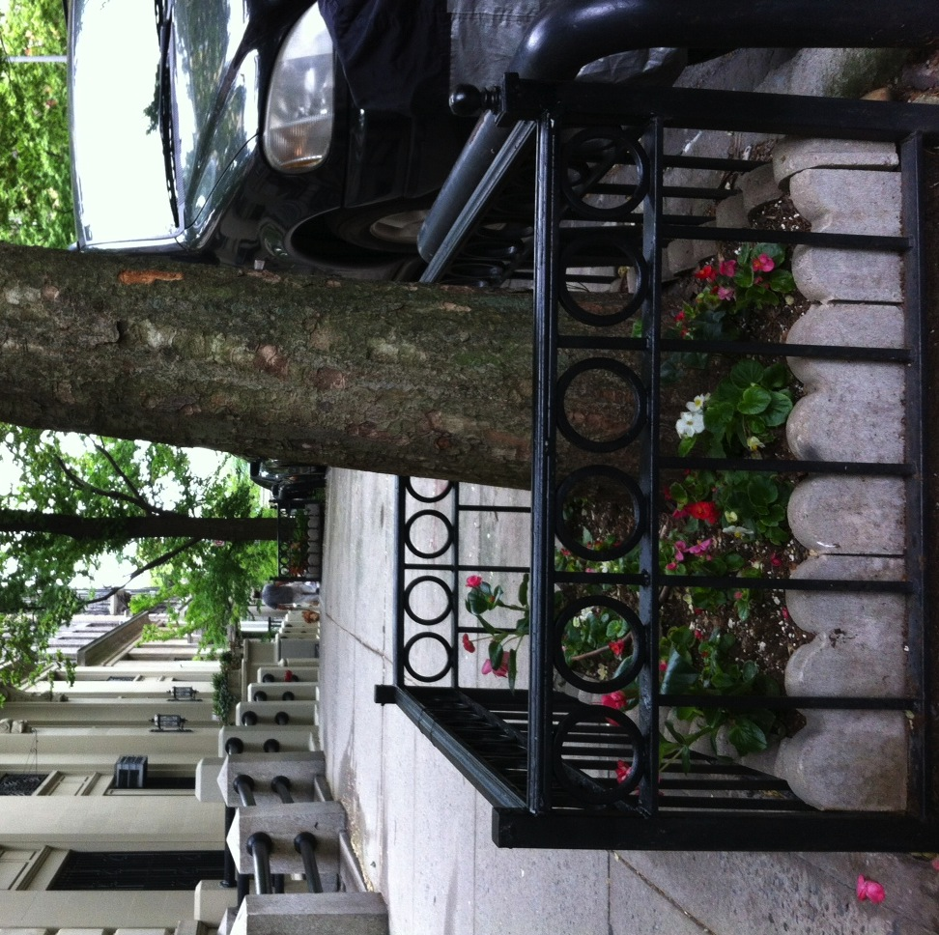

Slide 33
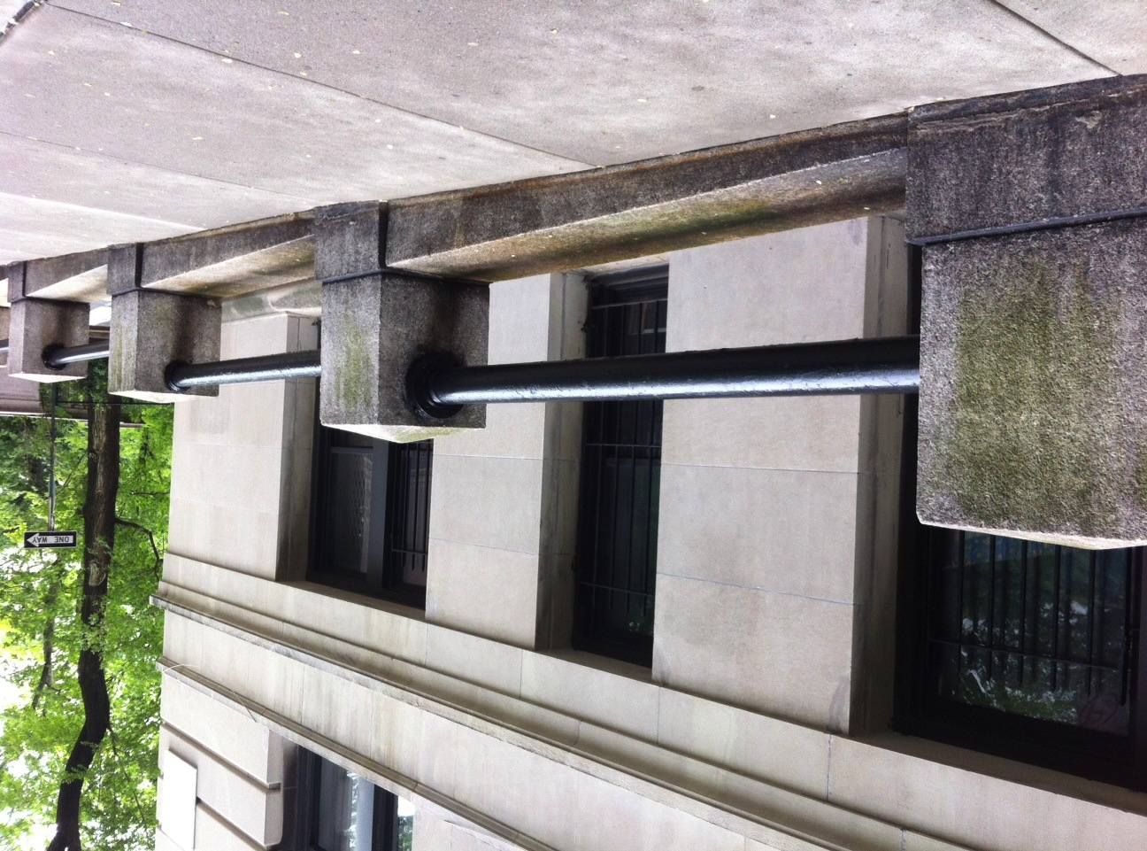

Slide 35
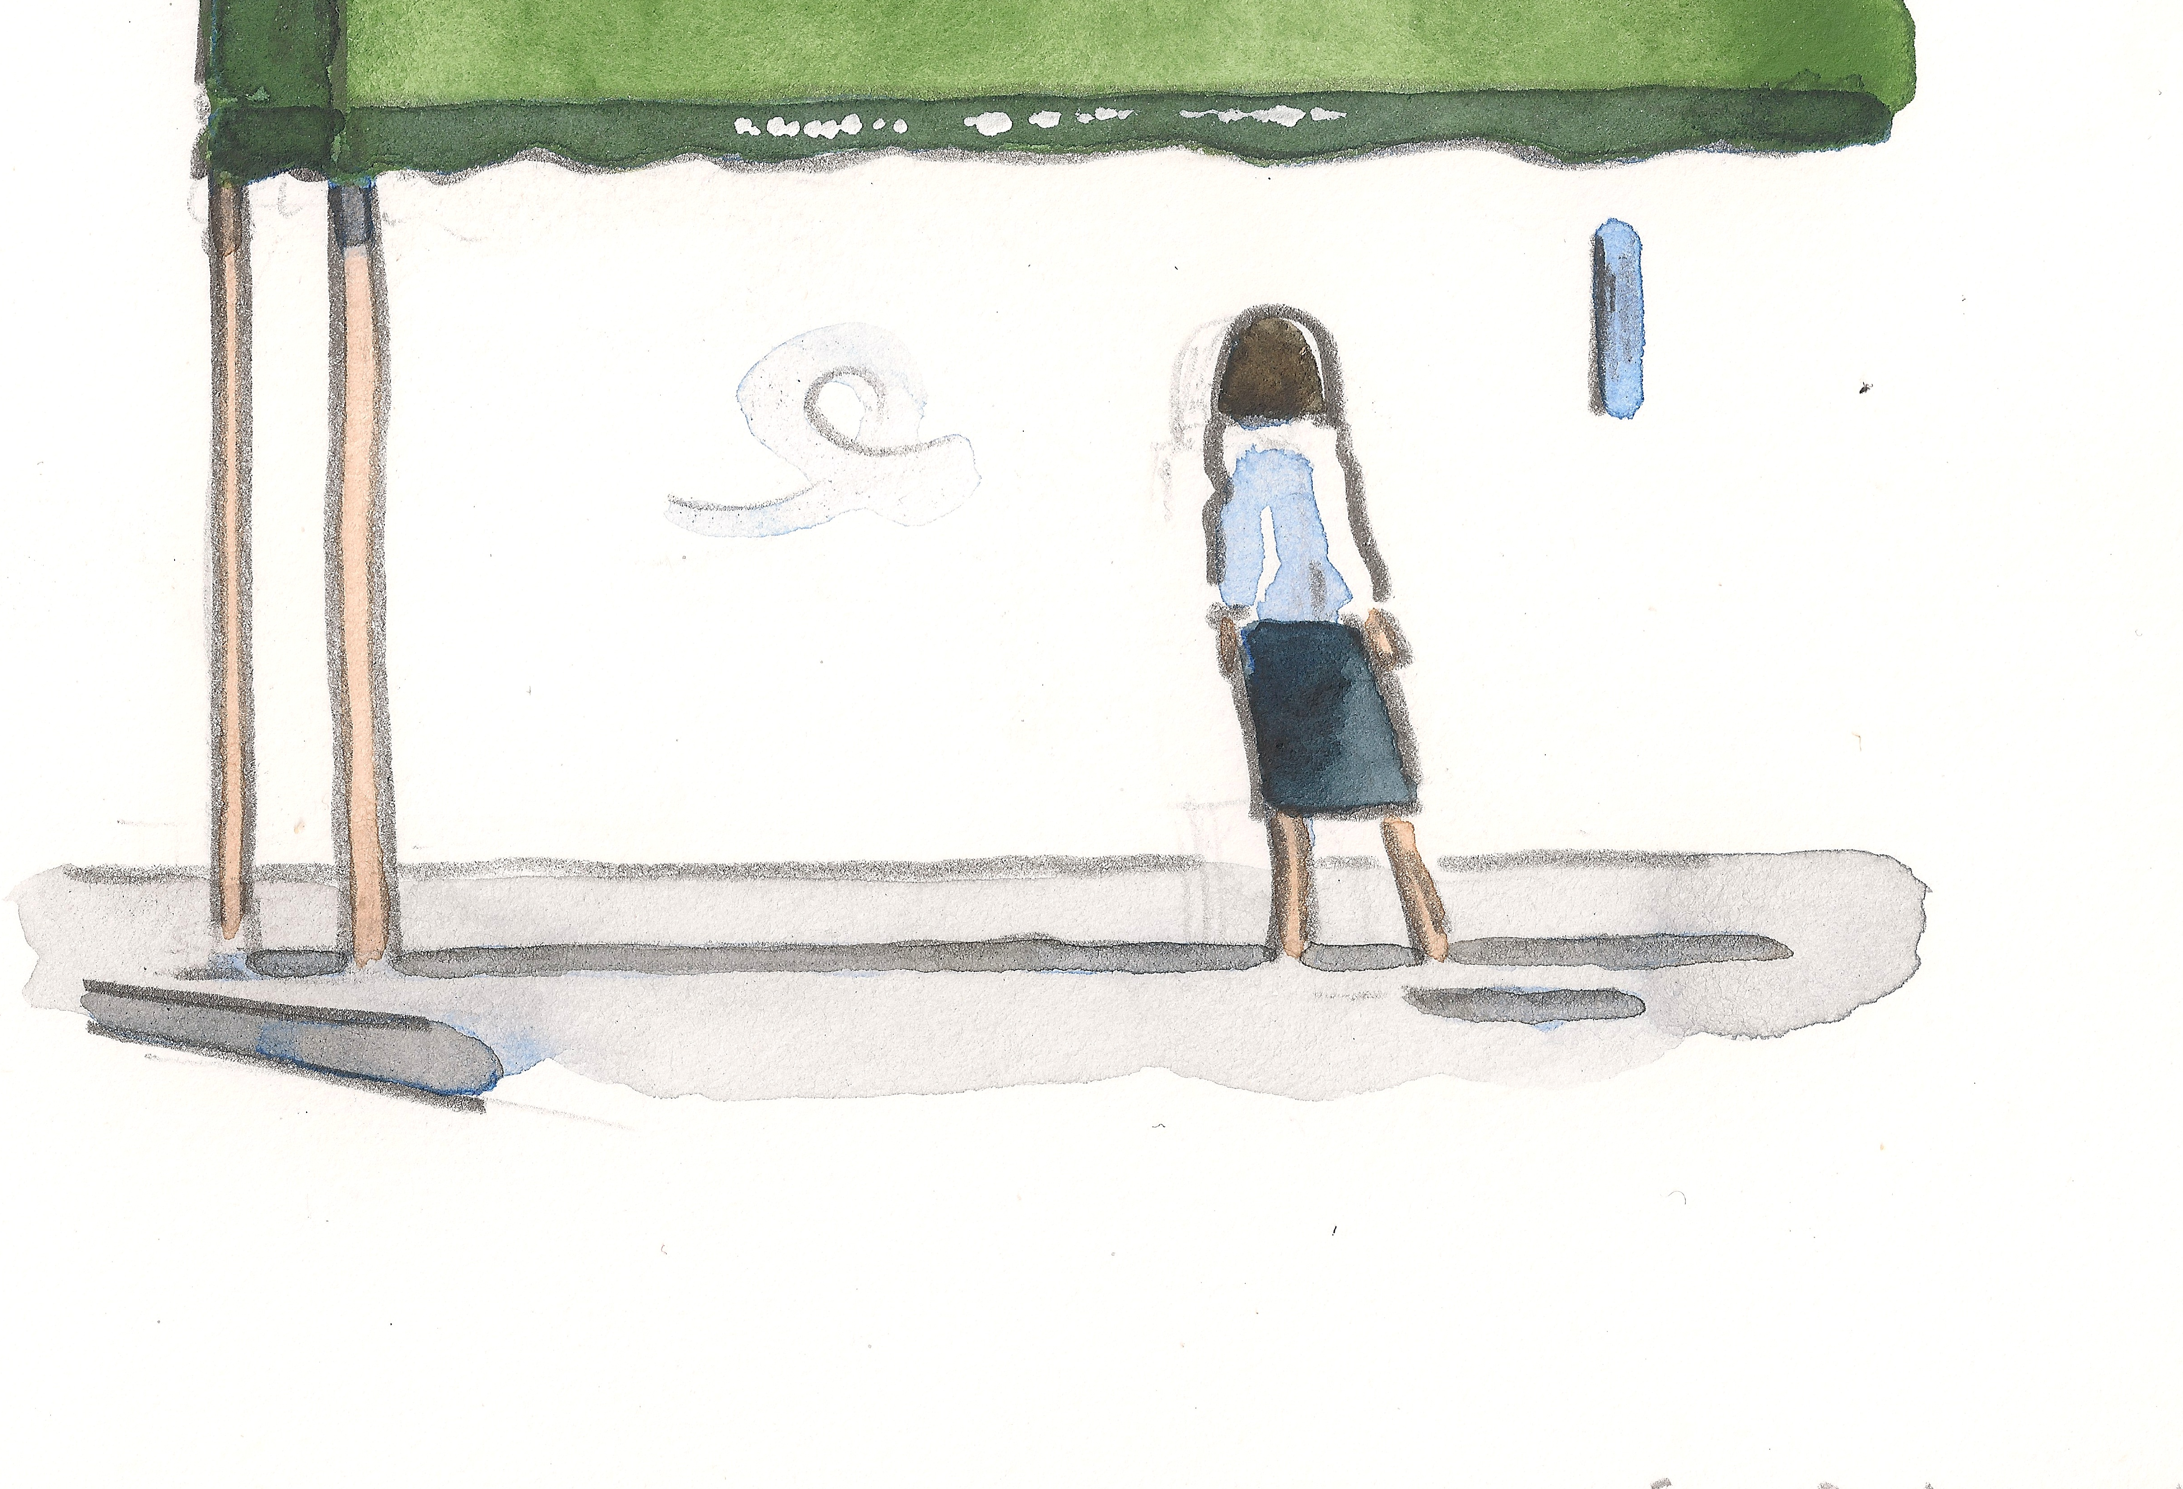
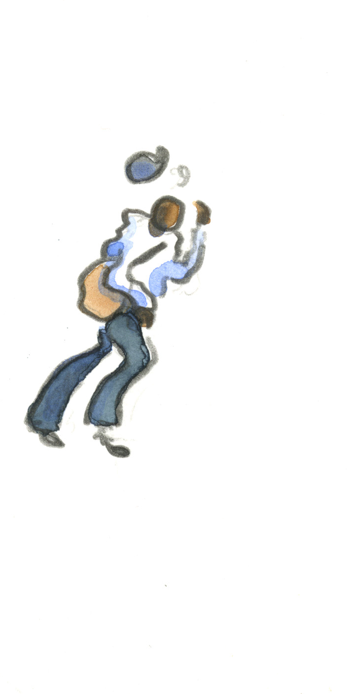
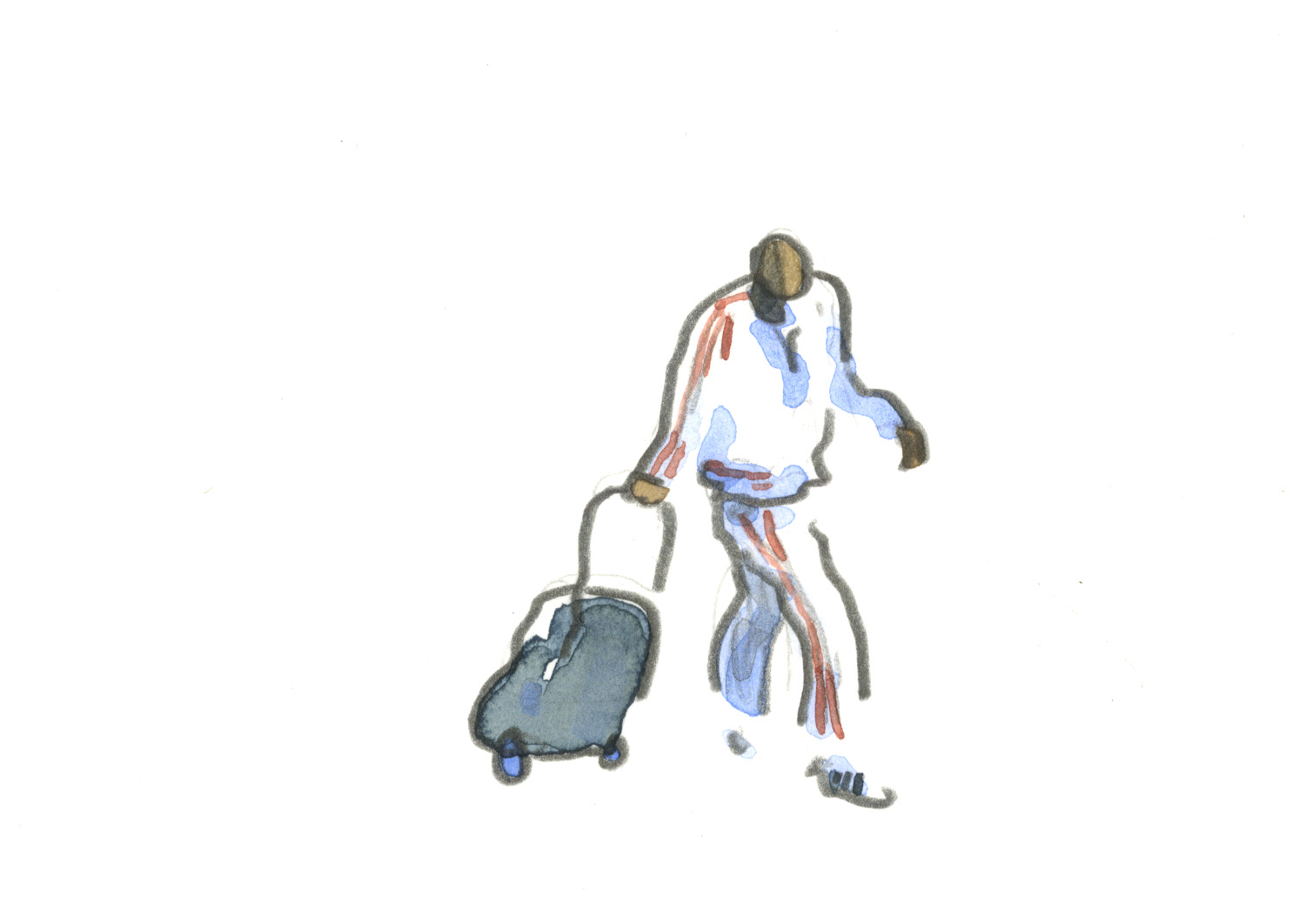

Slide 36


Notes:
36

Slide 37
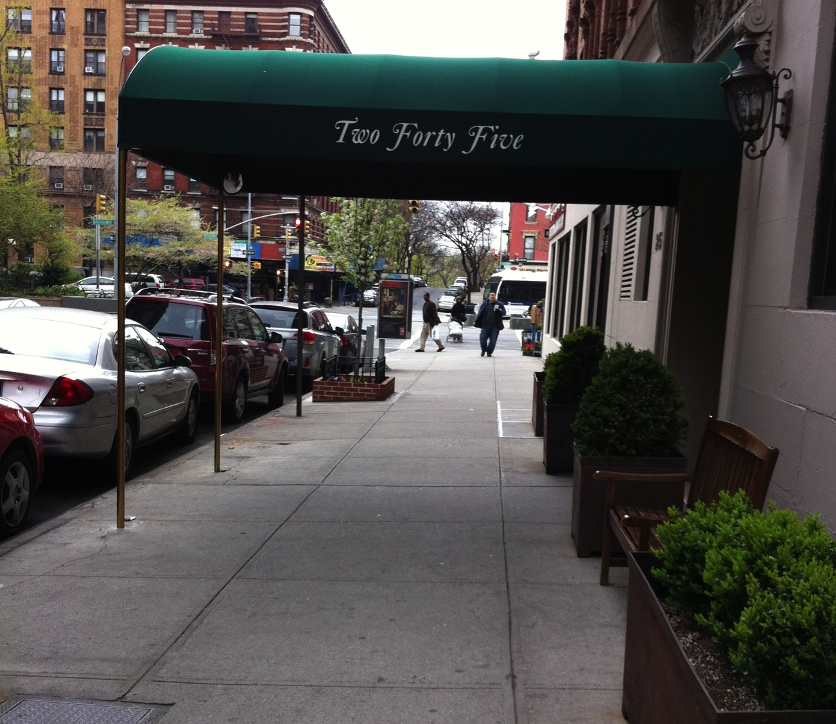
scaffolding

Slide 38
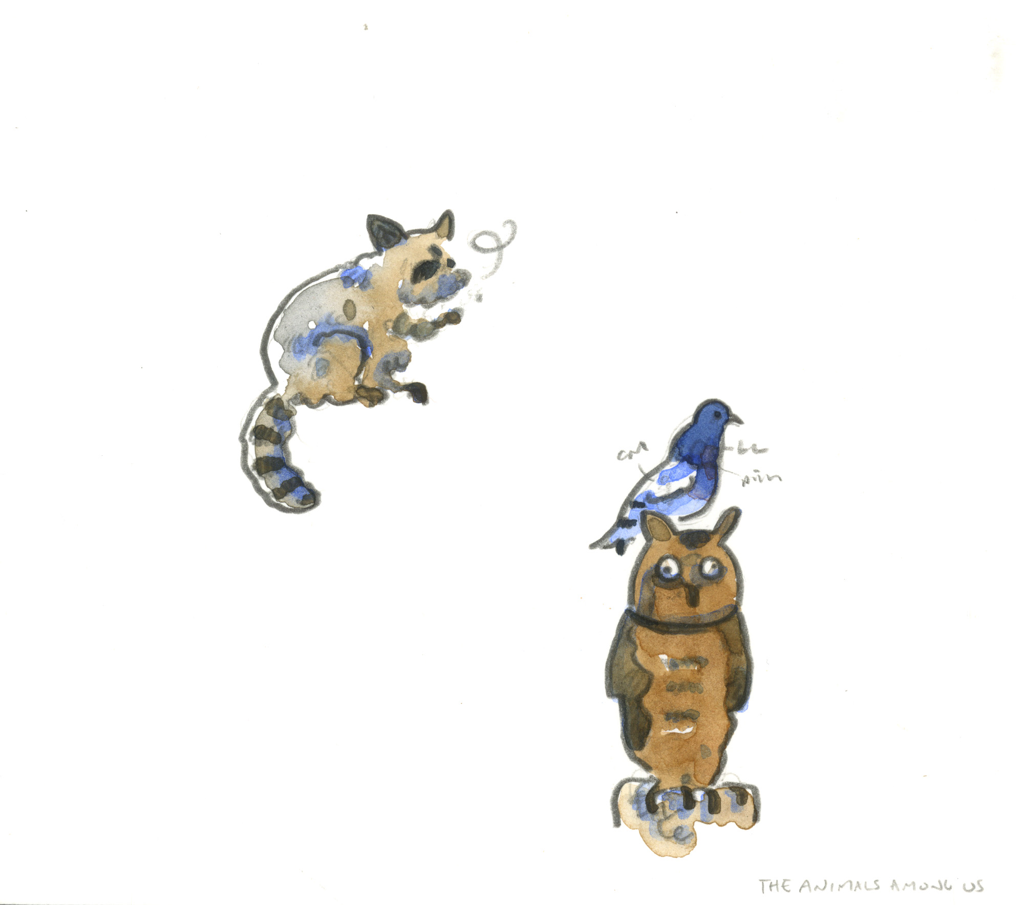

Slide 39
Notes:
39

Slide 40
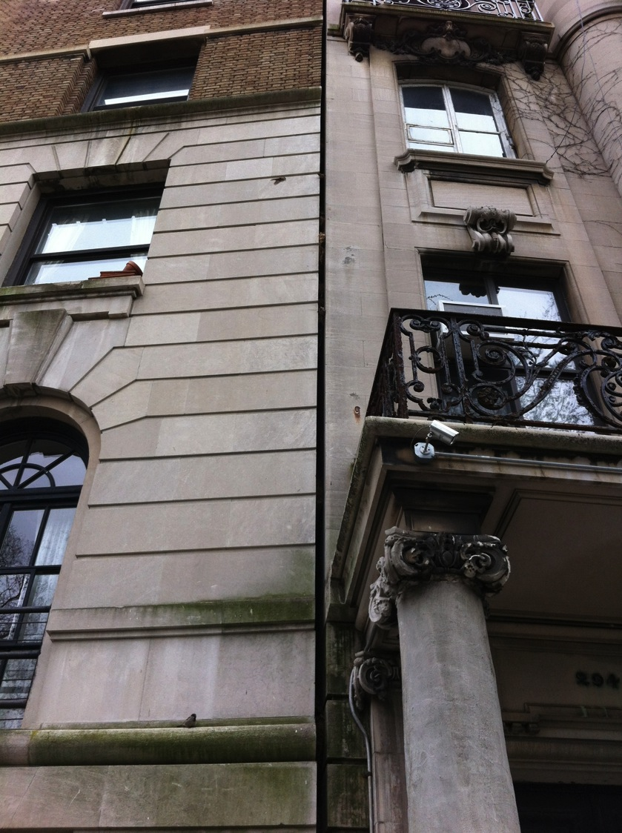

Slide 41
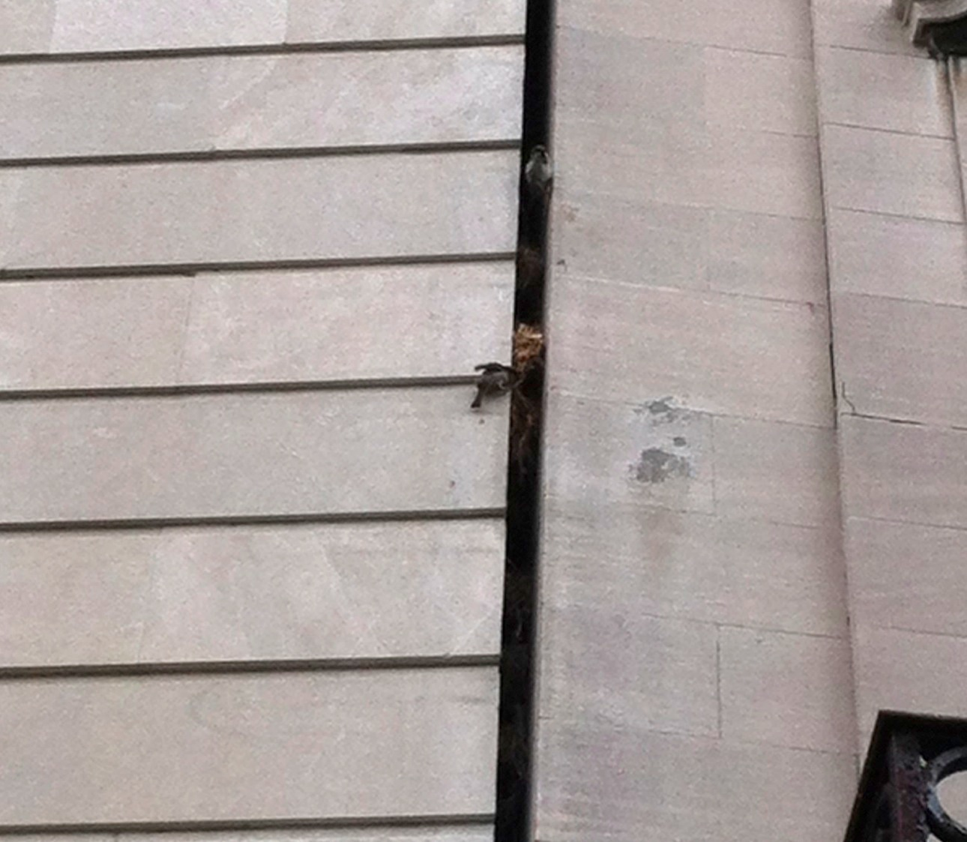

Slide 43
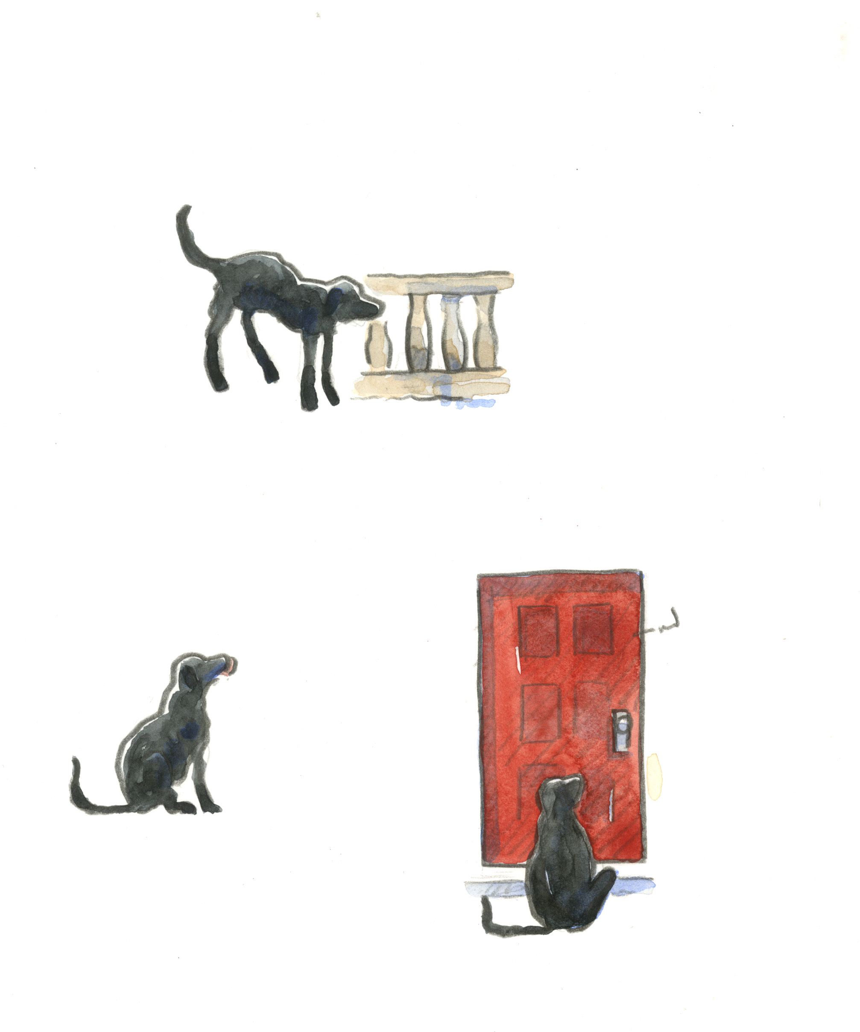

Slide 44
Notes:
44

Slide 45
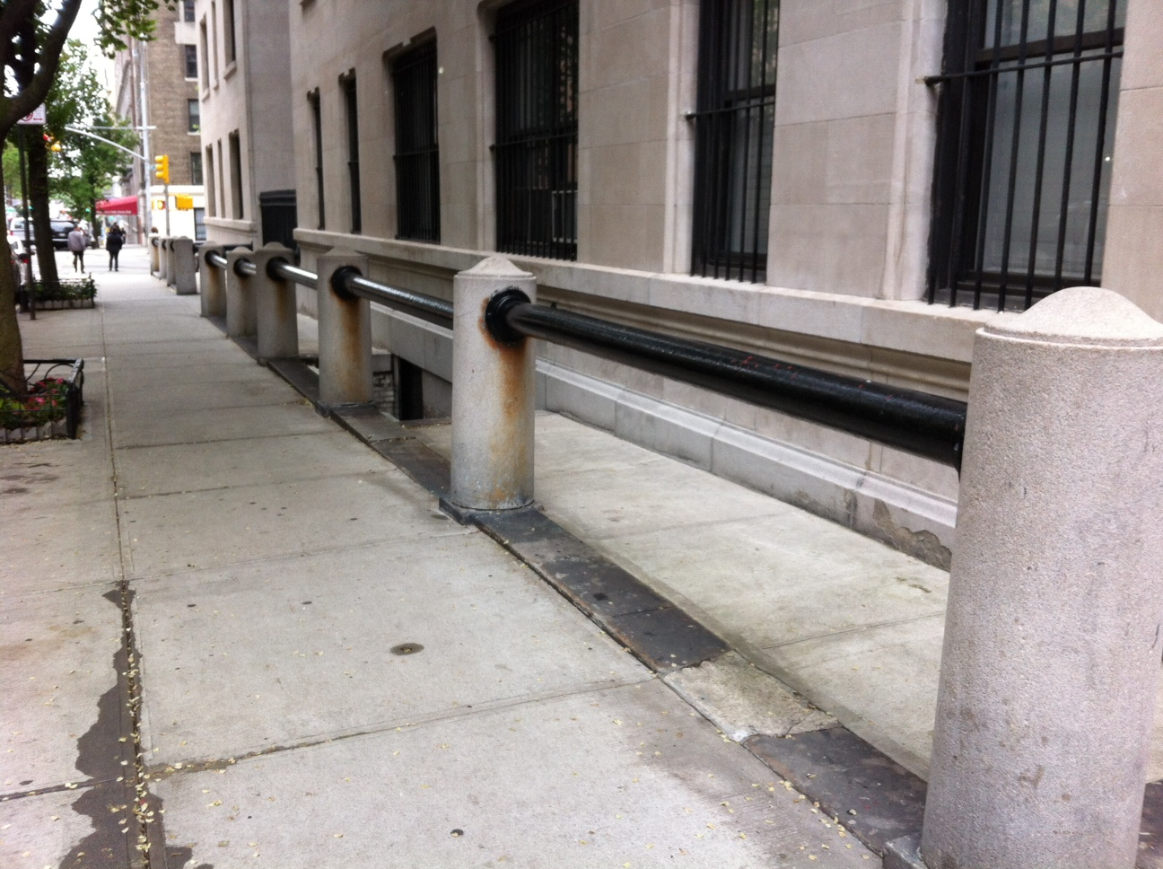

Slide 47
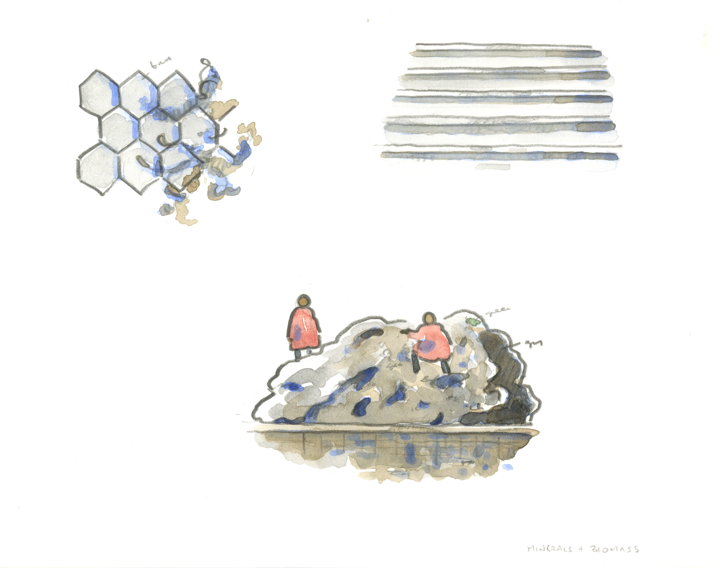

Slide 48
Notes:
48

Slide 49
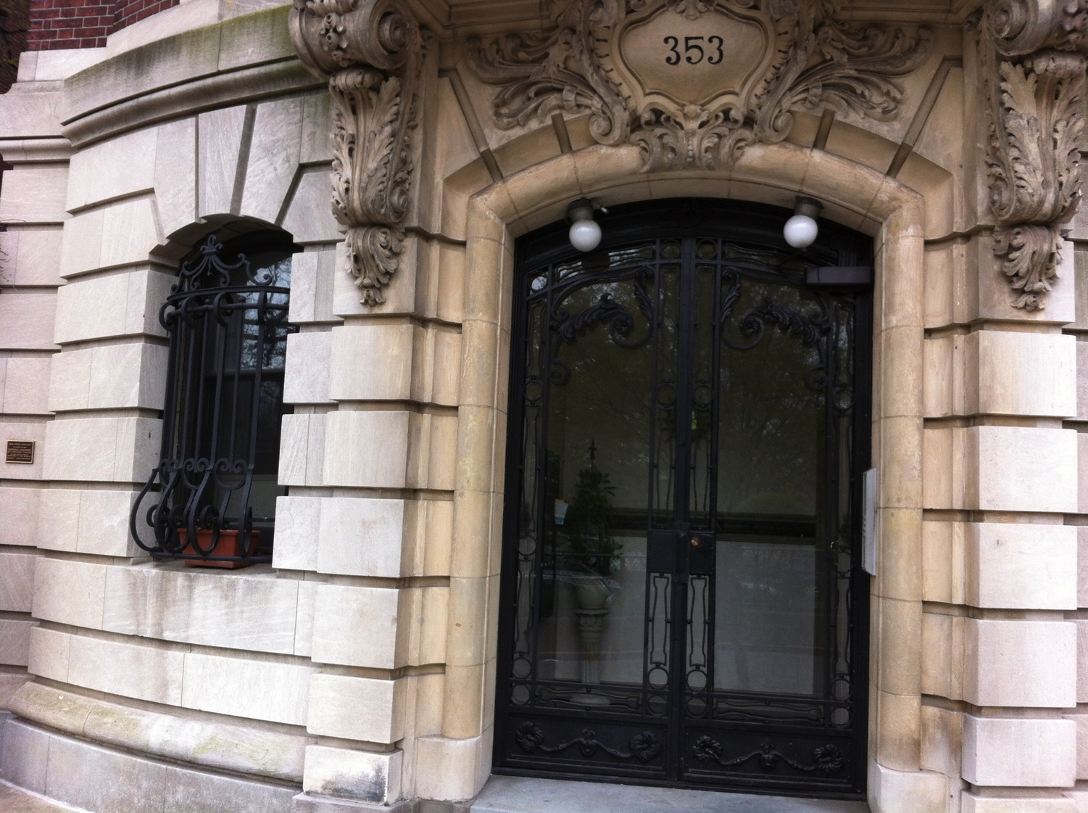

Slide 50
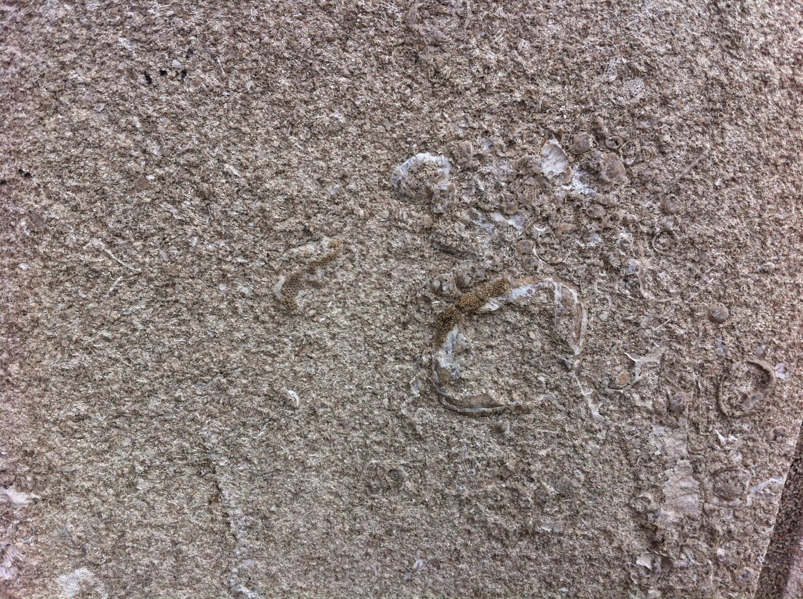

Slide 51
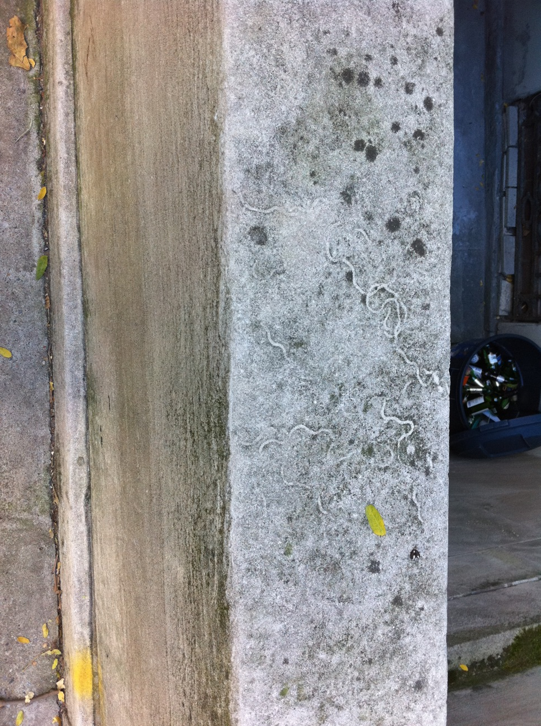

Slide 52
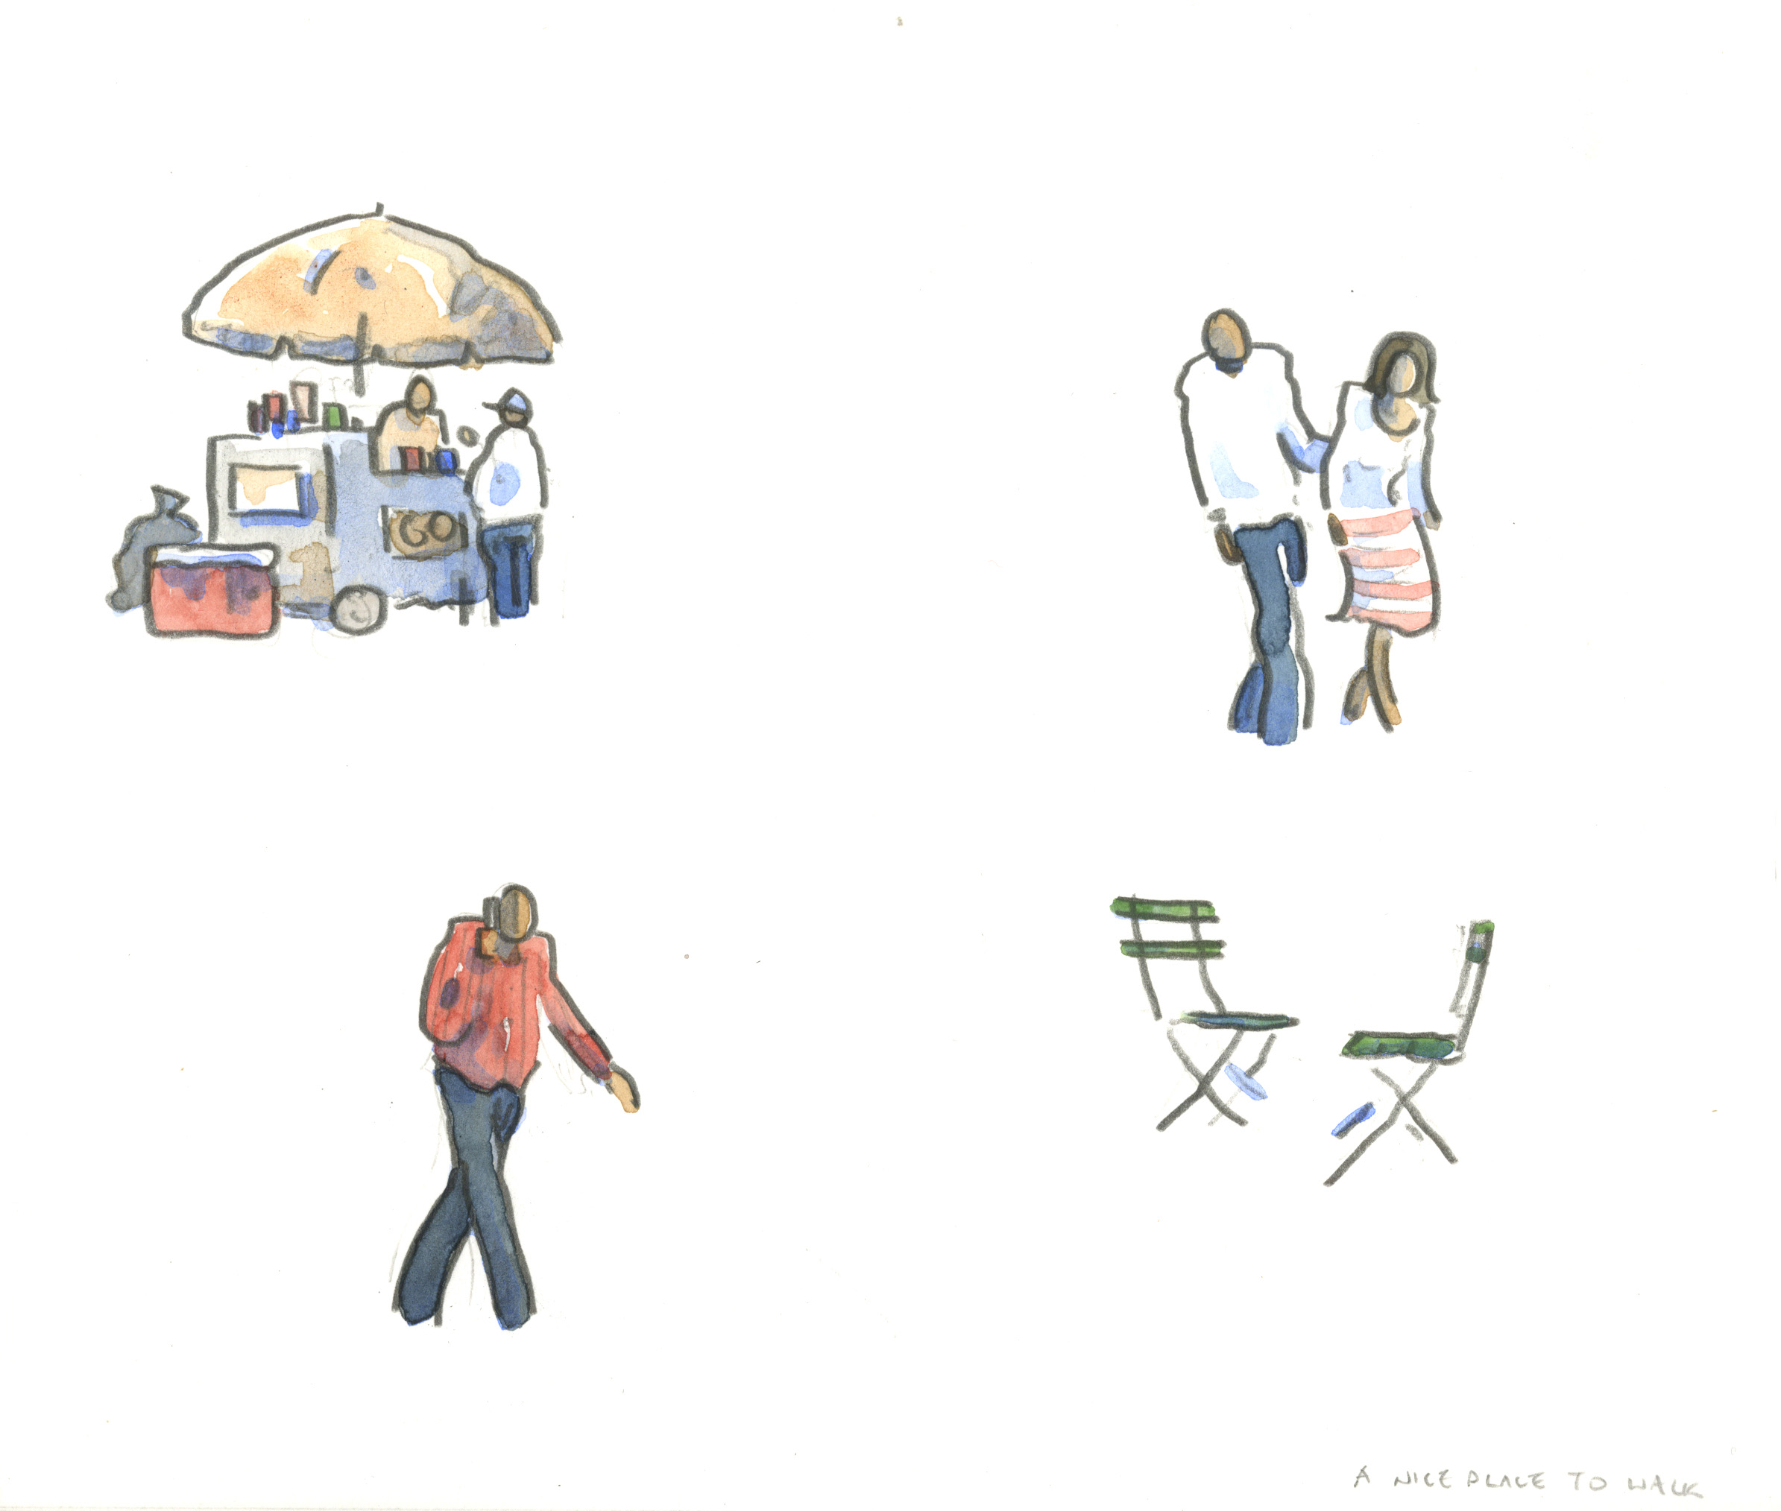

Slide 53
Notes:
53

Slide 54
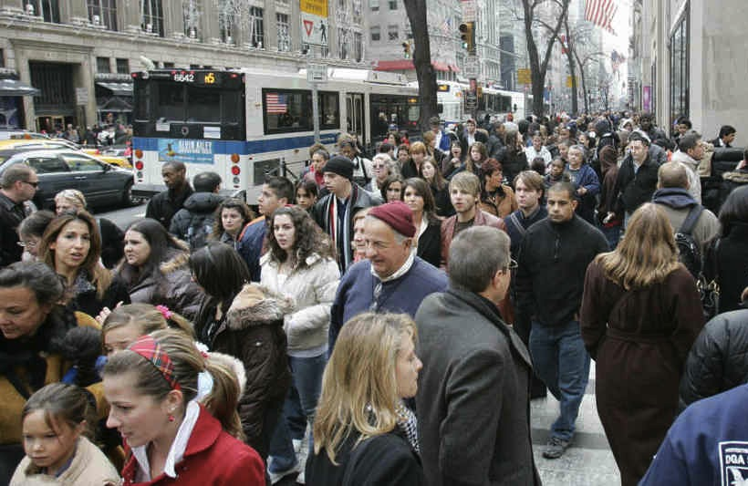
Npr.org

Slide 55
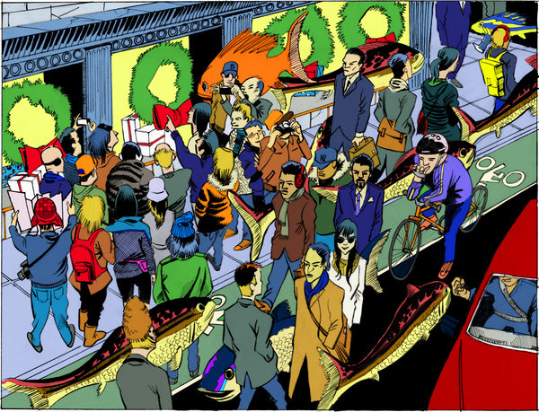

Slide 56
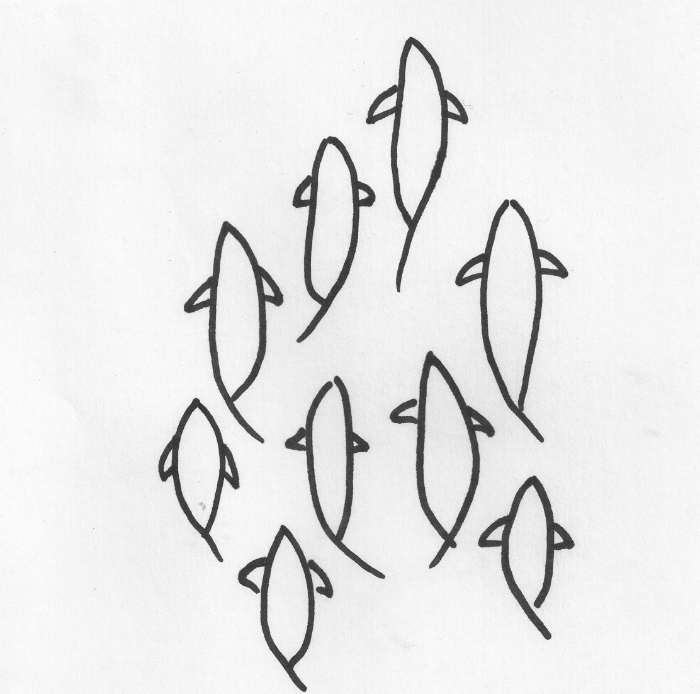

Slide 58


Slide 59


Slide 60
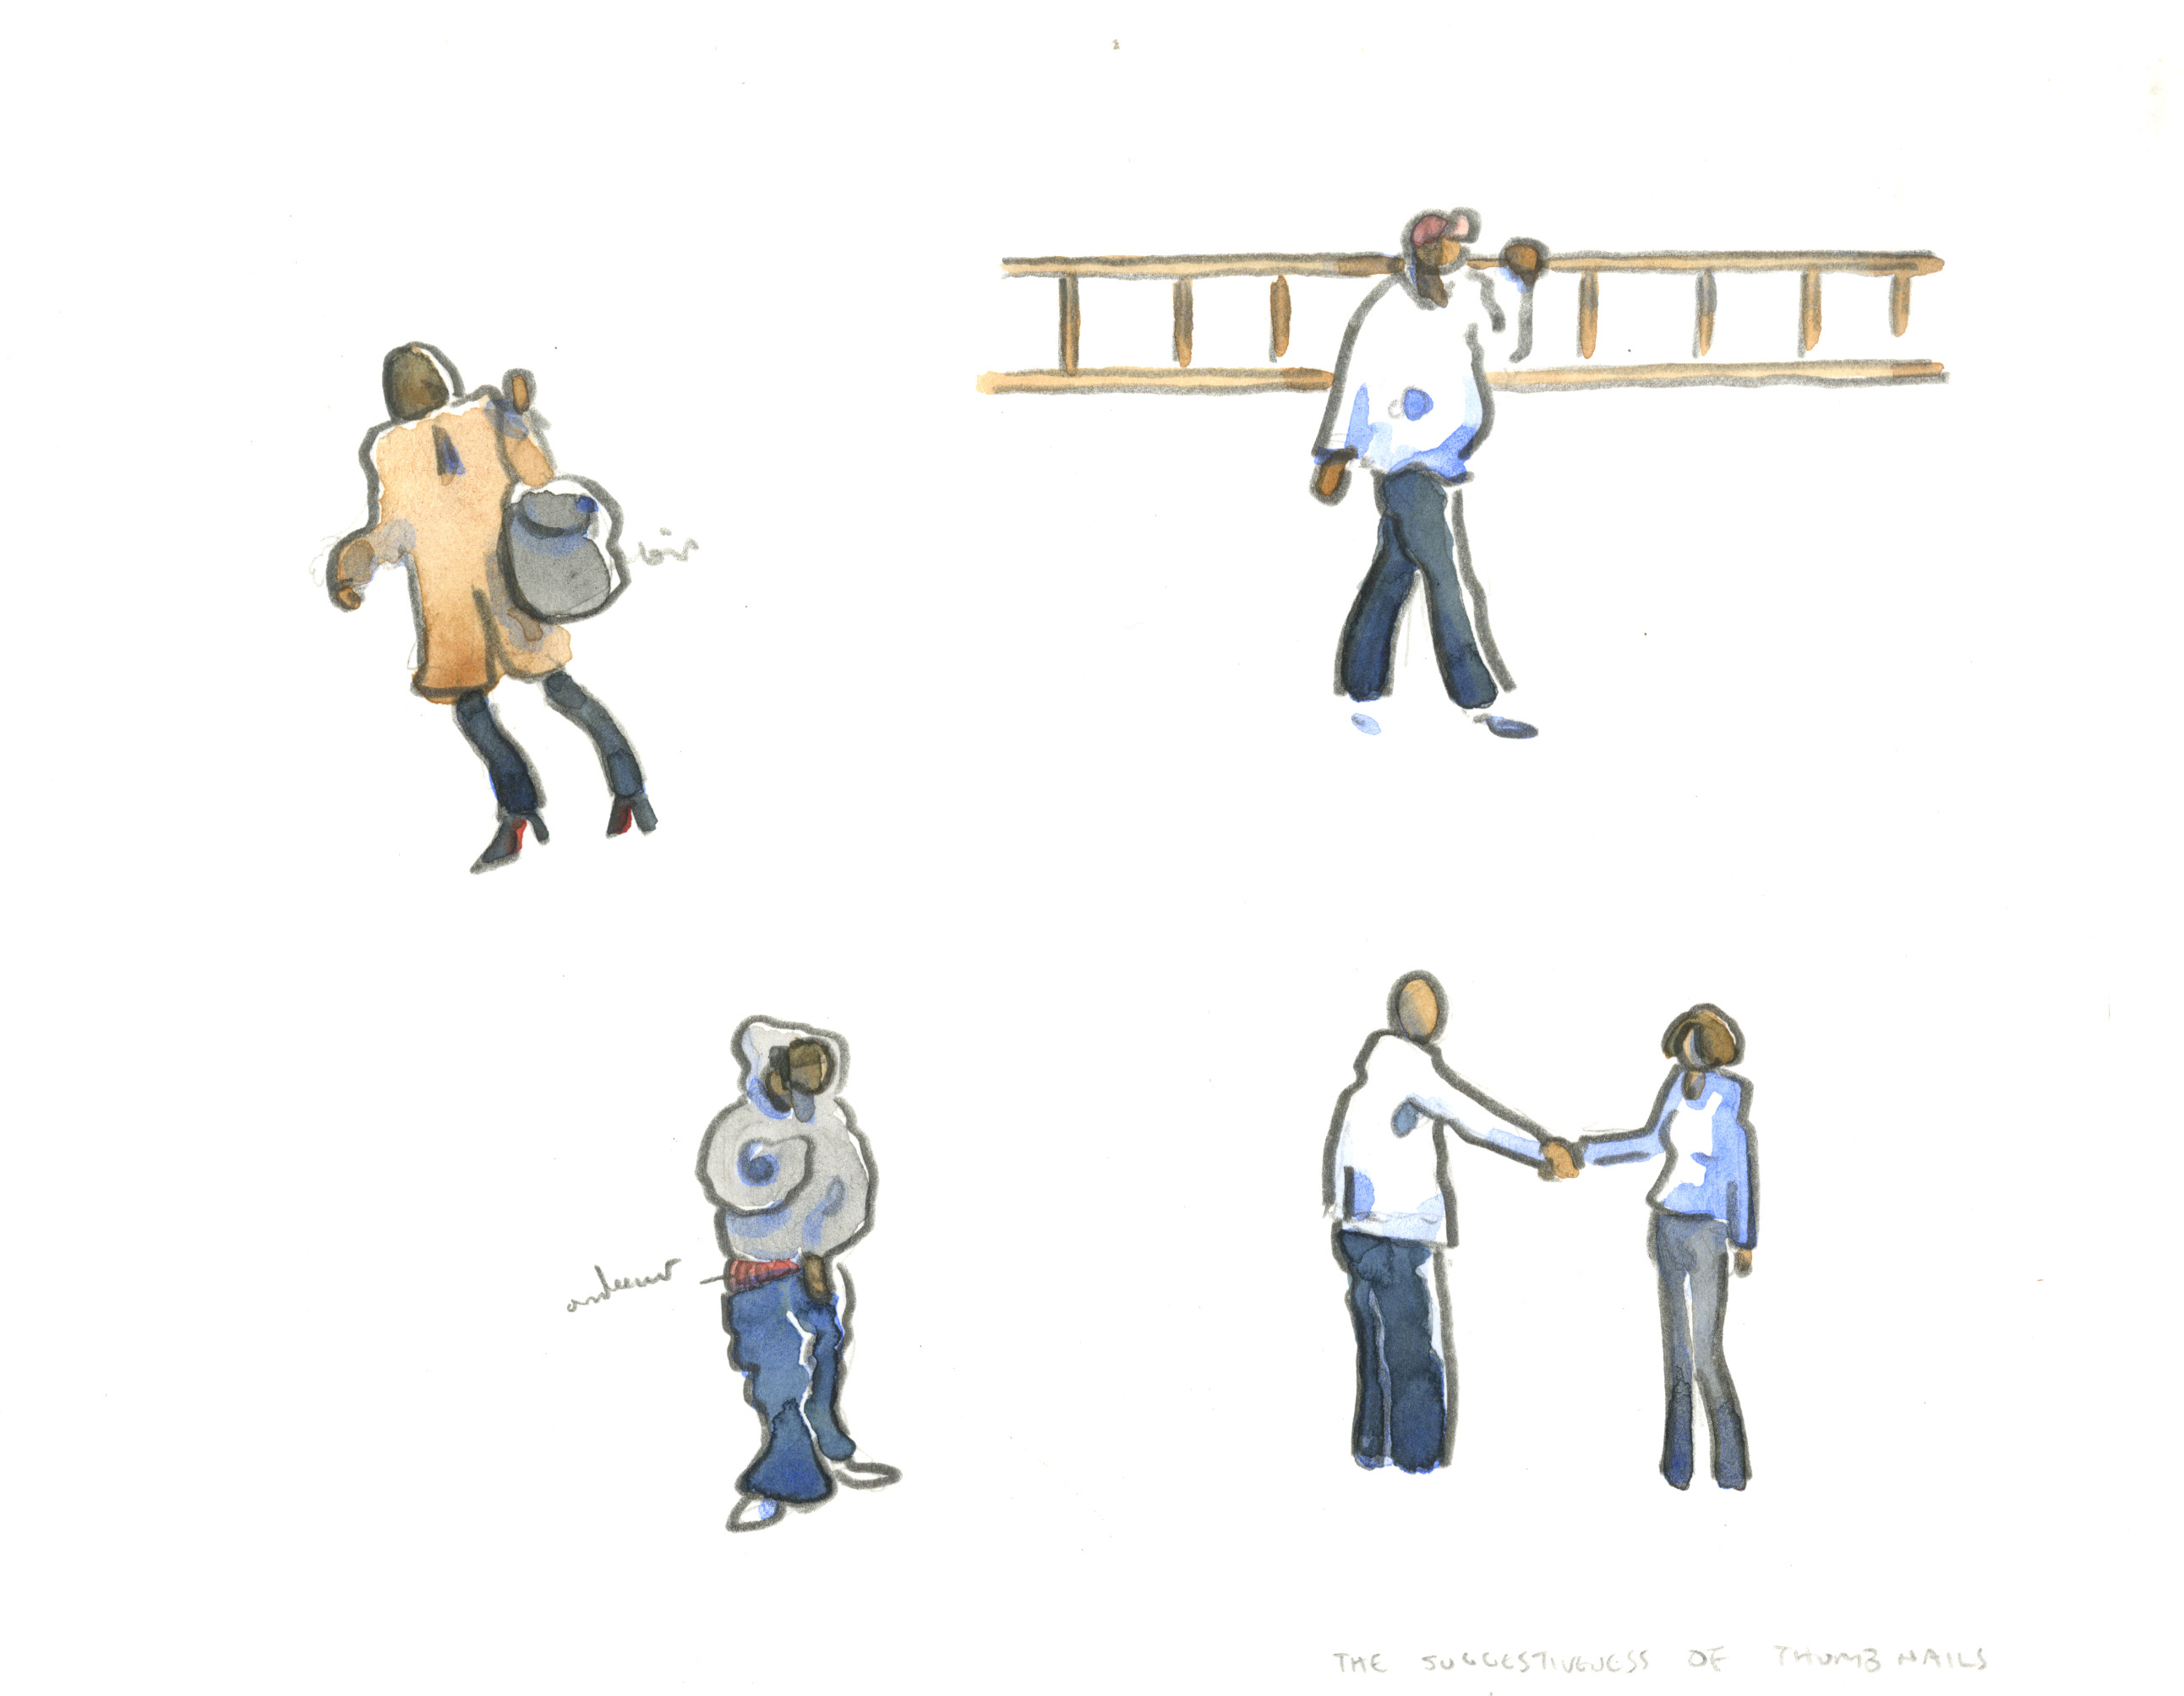

Slide 61
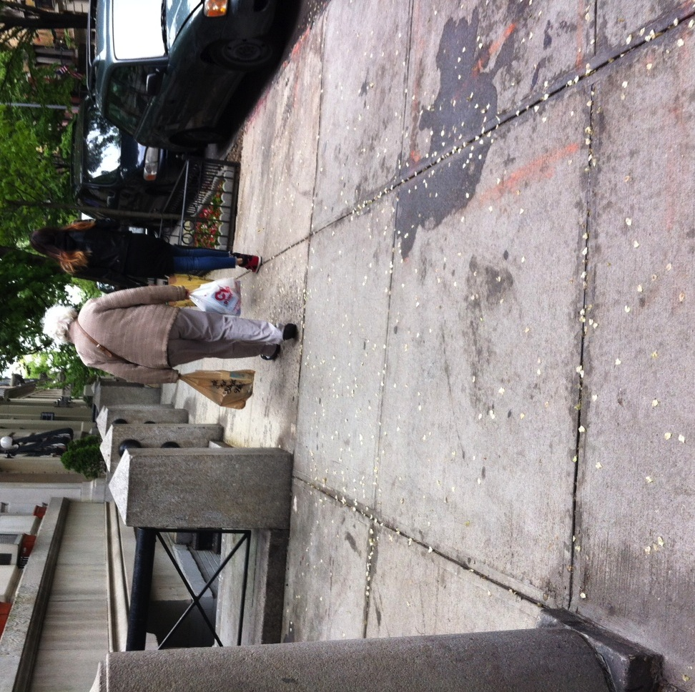

Slide 62
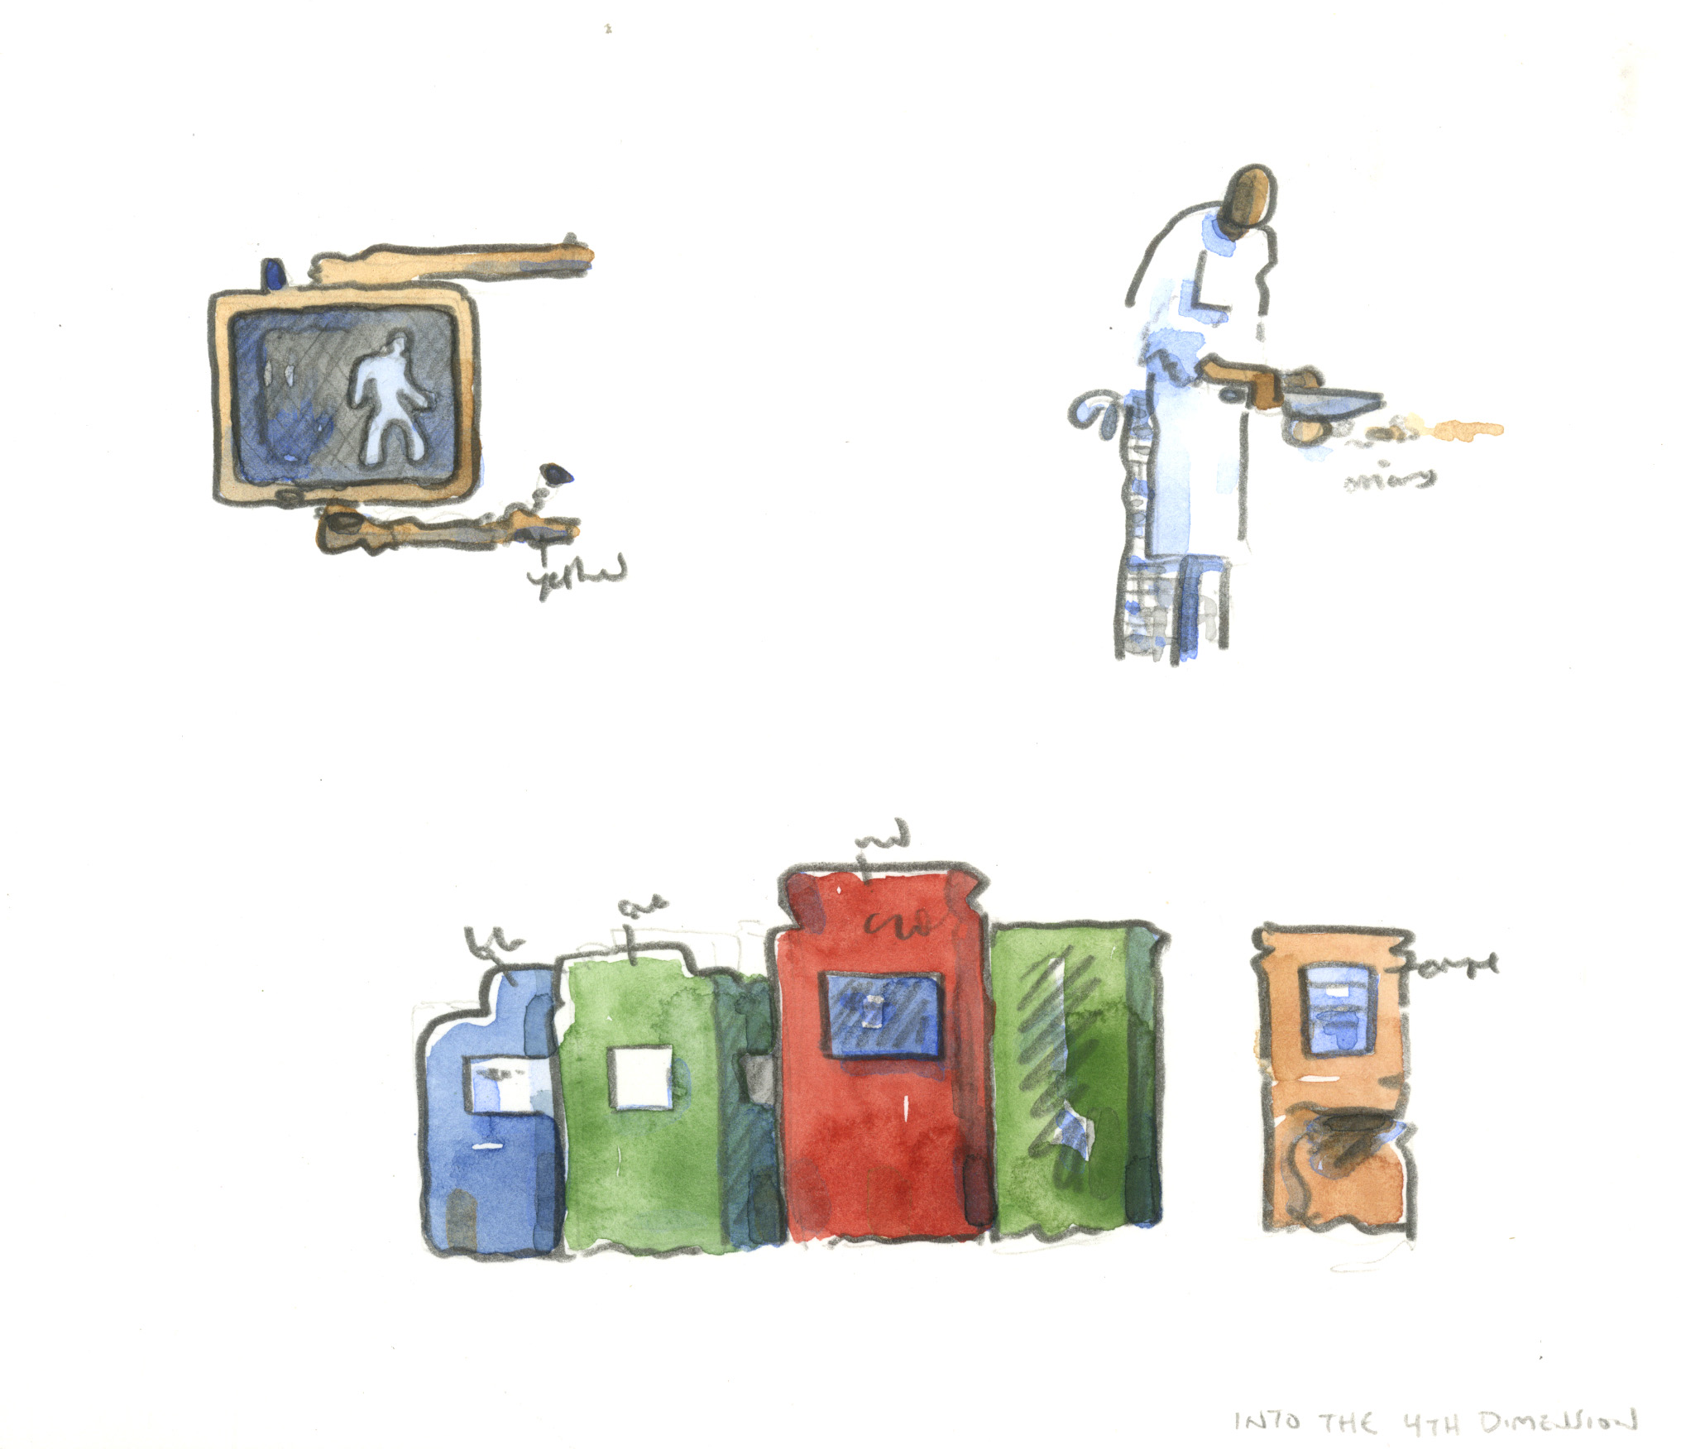

Slide 63
Notes:
63

Slide 64
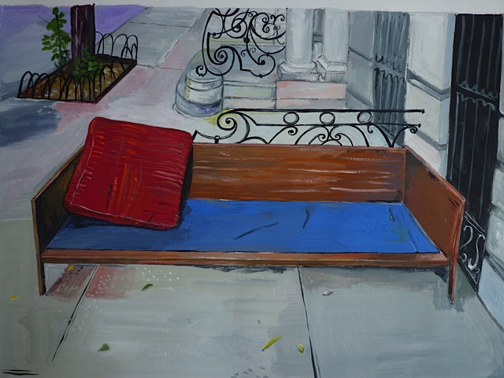
Maira Kalman

Slide 67
^{BREAK}
RETURN TO THEATER BY 11:45 AM
Sign up for this afternoon's IDEA EXCHANGES
and for tomorrow's Teaching Demonstrations

